Slide 2
The American Numismatic Association is a nonprofit educational organization dedicated to helping people discover and explore the world of money through its vast array of programs:
Publications
Educational Programs
Conventions & Seminars
Library
Money Museum

Slide 3
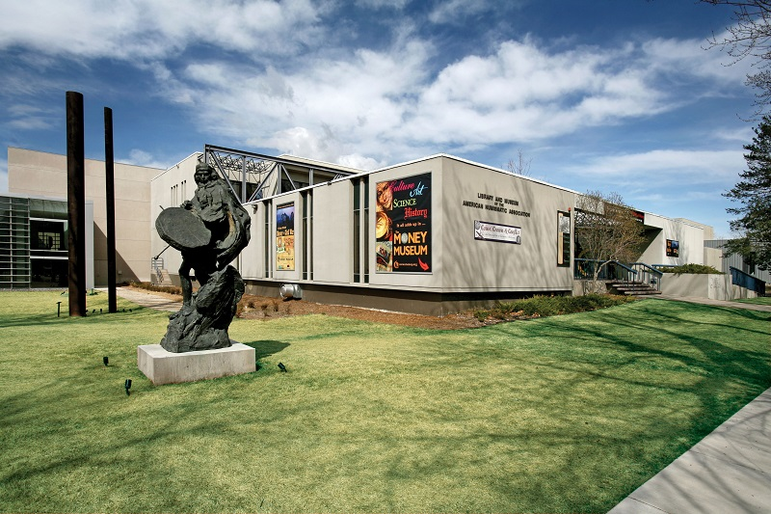
A Brief History of the ANA
“The foundation of the ANA was not laid for today alone but for the long and distant future.” —Dr. George F. Heath
The ANA was founded in October 1891 in Chicago.
In 1912, the Association gained national prominence when granted a Federal Charter, signed by President Taft.
In June of 1967, the ANA located its headquarters to Colorado Springs, Colo. where it remains today.

Slide 4
The Numismatist
The official publication of the ANA focuses on the fun, the history and the allure of coin collecting.
Published for over 130 years
Original articles written by leading voices in numismatics
Digital archives of every issue

Slide 5
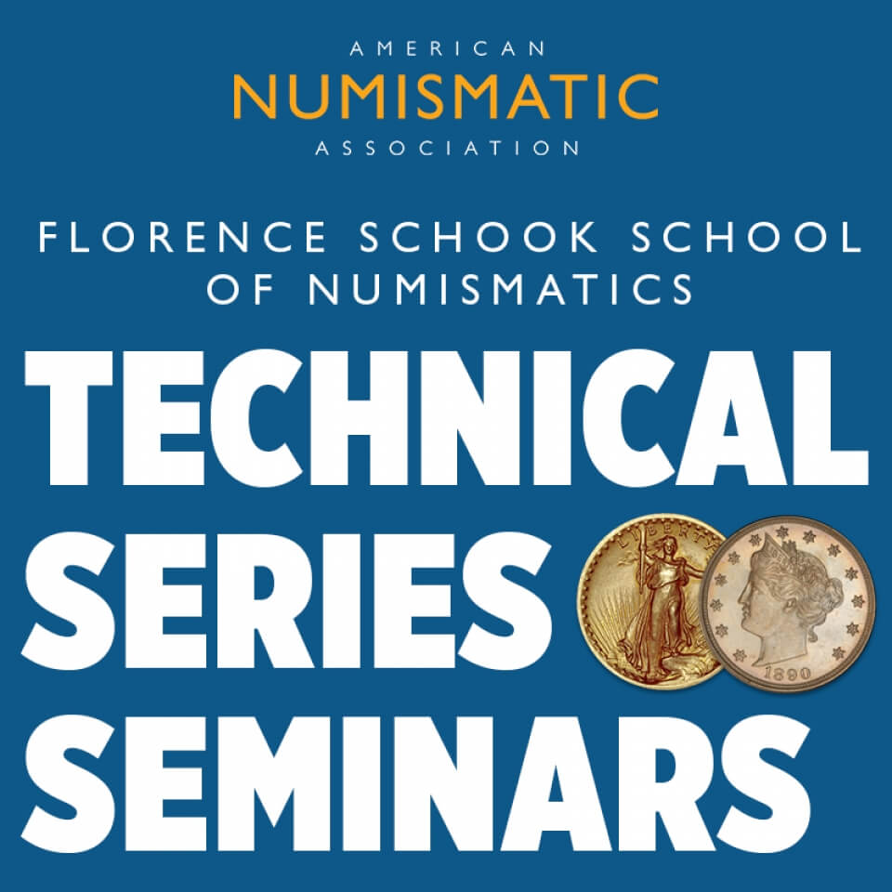
Educational Programs:
Technical Seminars
The ANA has built a reputation for high-quality, hands-on numismatic learning opportunities through the Technical Series Seminars.
With some of the best instructors in the industry and small class sizes, connections between student and instructors can be formed, providing an opportunity for professional camaraderie and networking.
These seminars align with different numismatic conventions throughout the nation, teaching how to grade coins, how to detect counterfeits, coin photography and more.

Slide 6
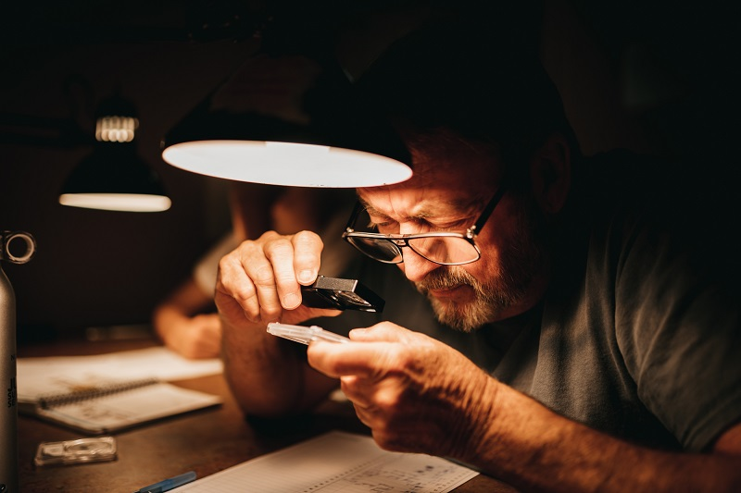
Educational Programs:
Summer Seminar
An annual two-week event for numismatic learning and camaraderie that offers students a varied selection of week-long courses designed for discovery or continued study.
Over 50 years of Summer Seminar
Scholarship opportunities
Over 40 classes to choose from
Freedom to build friendships and meet inspirational hobby leaders

Slide 7
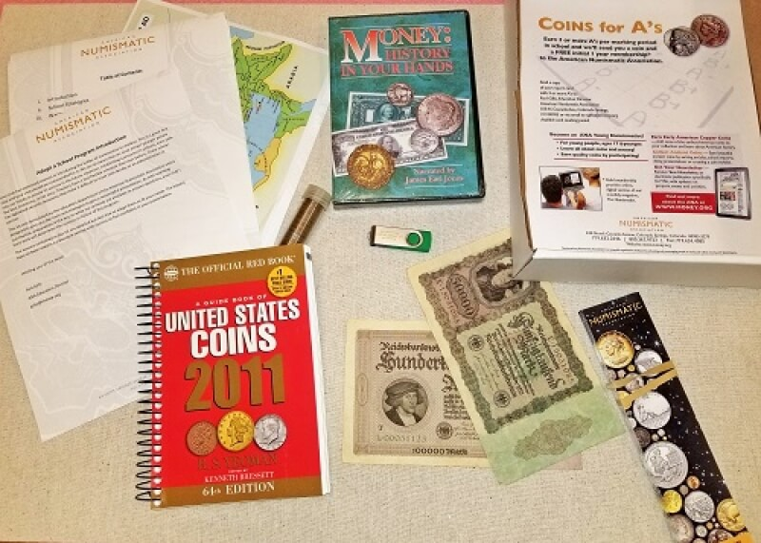
Educational Programs:
Coins in the Classroom
The ANA provides lesson plans on various numismatic topics for teachers.
The ANA also offers Adopt-A-School Program Educational Kits. Each kit includes instructions to all the different lesson plans, which can be used by parents, district representatives or club members.

Slide 8
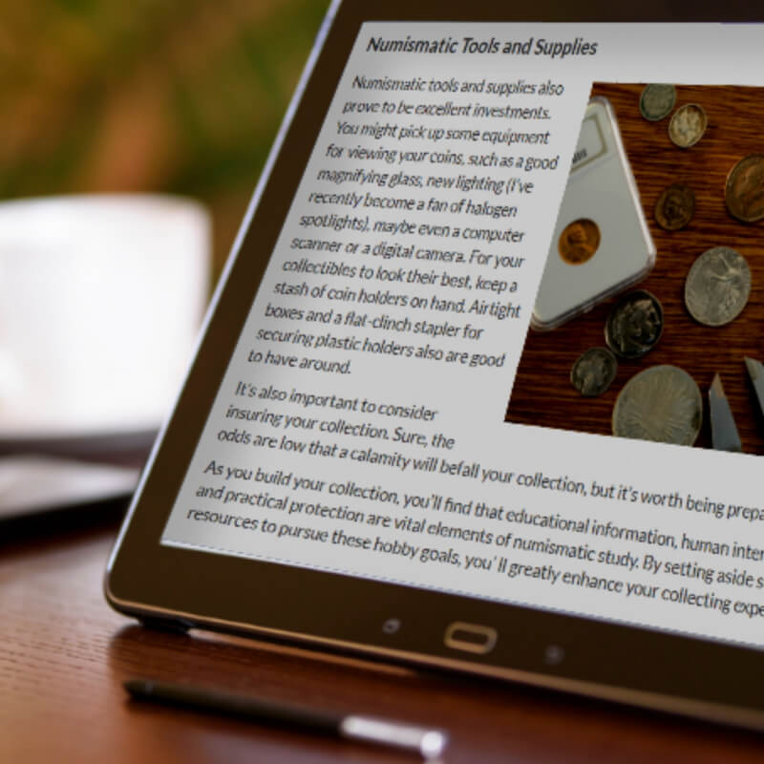
Educational Programs:
Online Resources
The ANA provides robust collector resources for all collecting levels on money.org. Resources include:
Consumer resources
Informative eBooks
Videos
Coin Dealer Directory
Coin Club Directory
Links to numismatic websites

Slide 9
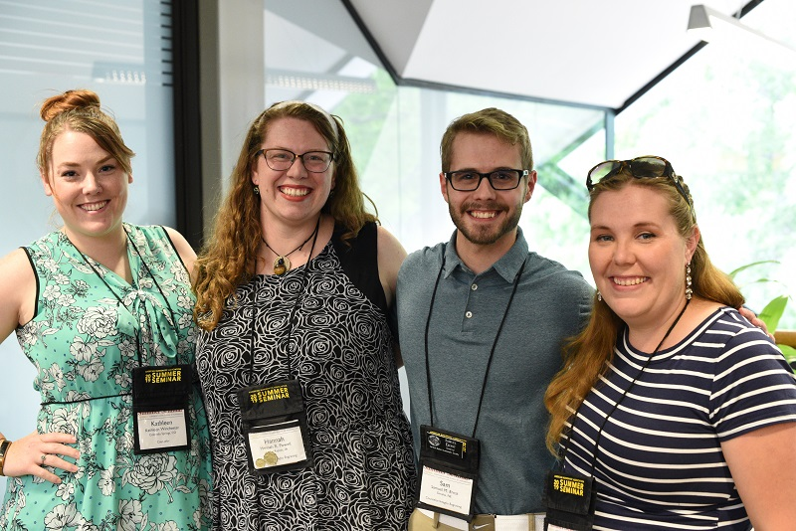
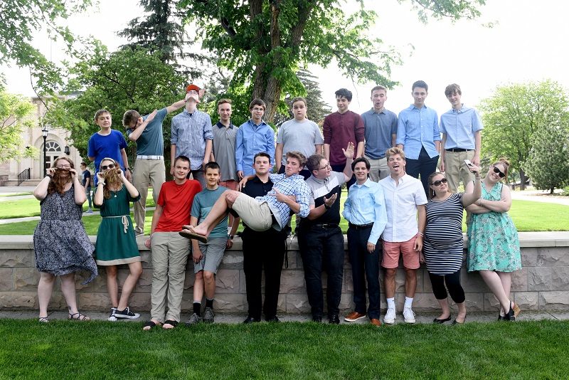
Educational Programs:
Young Numismatists
The future of the hobby is dependent on younger audiences becoming interested in collecting. The ANA supports Young Numismatists with:
Specialized educational programs
Free coins
Scholarship opportunities
Games and trivia
Videos

Slide 10
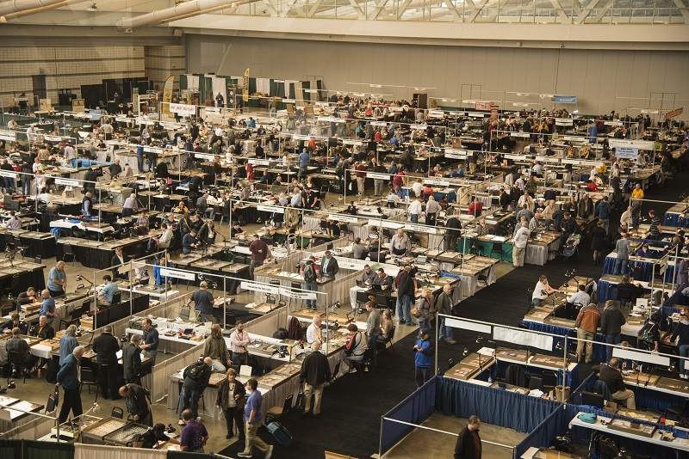
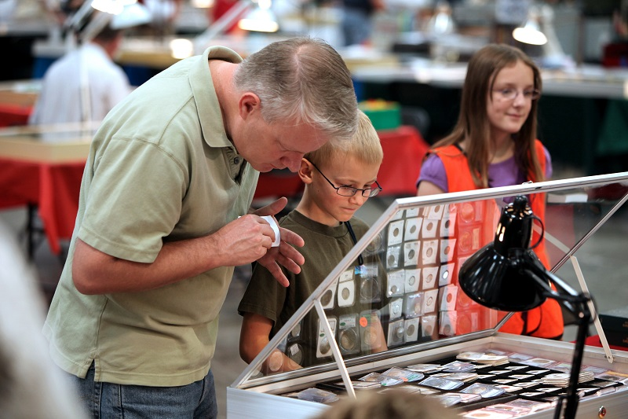
Annual ANA Conventions:
National Money Show® & World’s Fair of Money®
Hundreds of dealers
Educational programming
Live auctions
Exhibits of rare historical numismatic items
Family-friendly activities

Slide 11
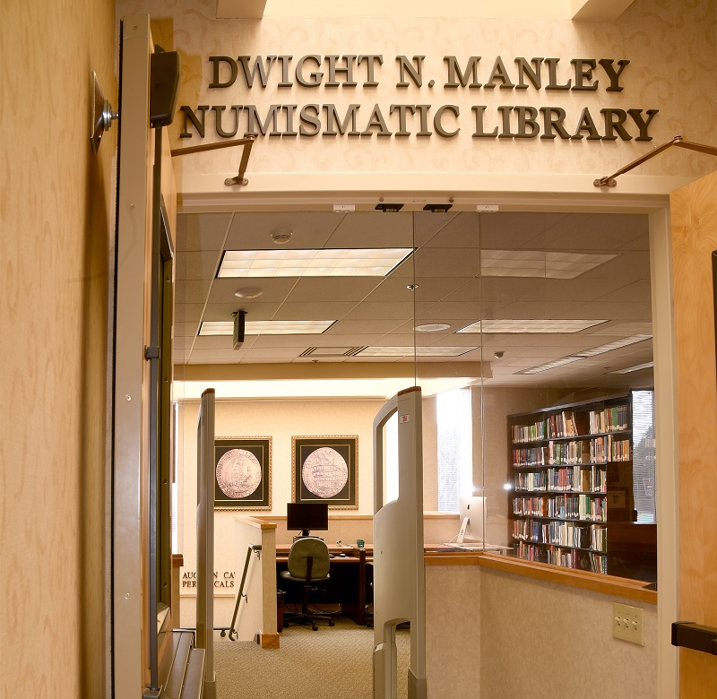
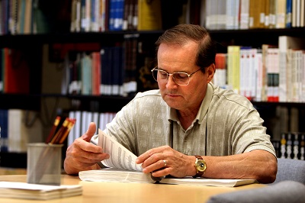
ANA Numismatic Library
The world’s largest numismatic lending library with more than 128,000 books, auction catalogs, periodicals and DVDs.
Members have free borrowing privileges.

Slide 12
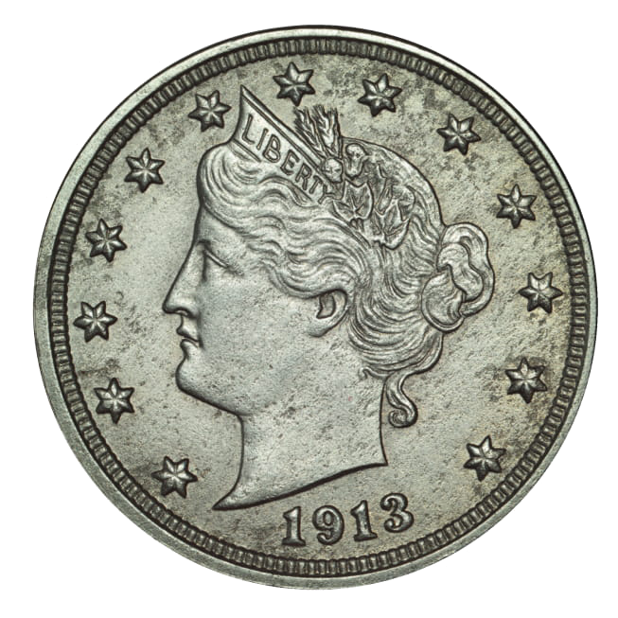
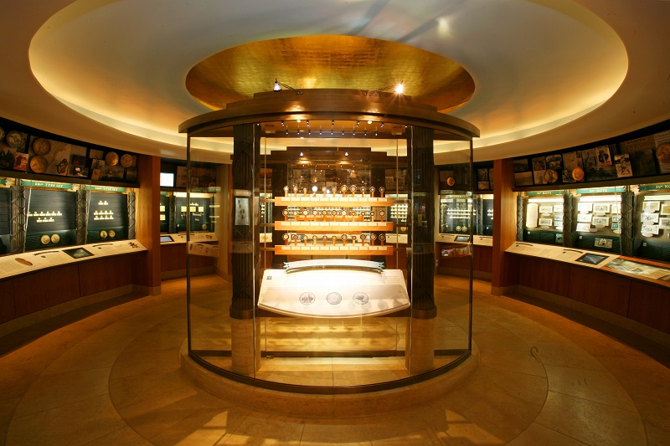
ANA Money Museum
The museum explores art, history, science and much more to promote the diverse nature of money and related items. Visitors can find spectacular rarities and learn about history through the world of money.
America’s largest museum dedicated to numismatics
Three main galleries
Virtual exhibits

Slide 13
money.org
800-367-9723
Notes:
Questions and Discussion

