Slide 1
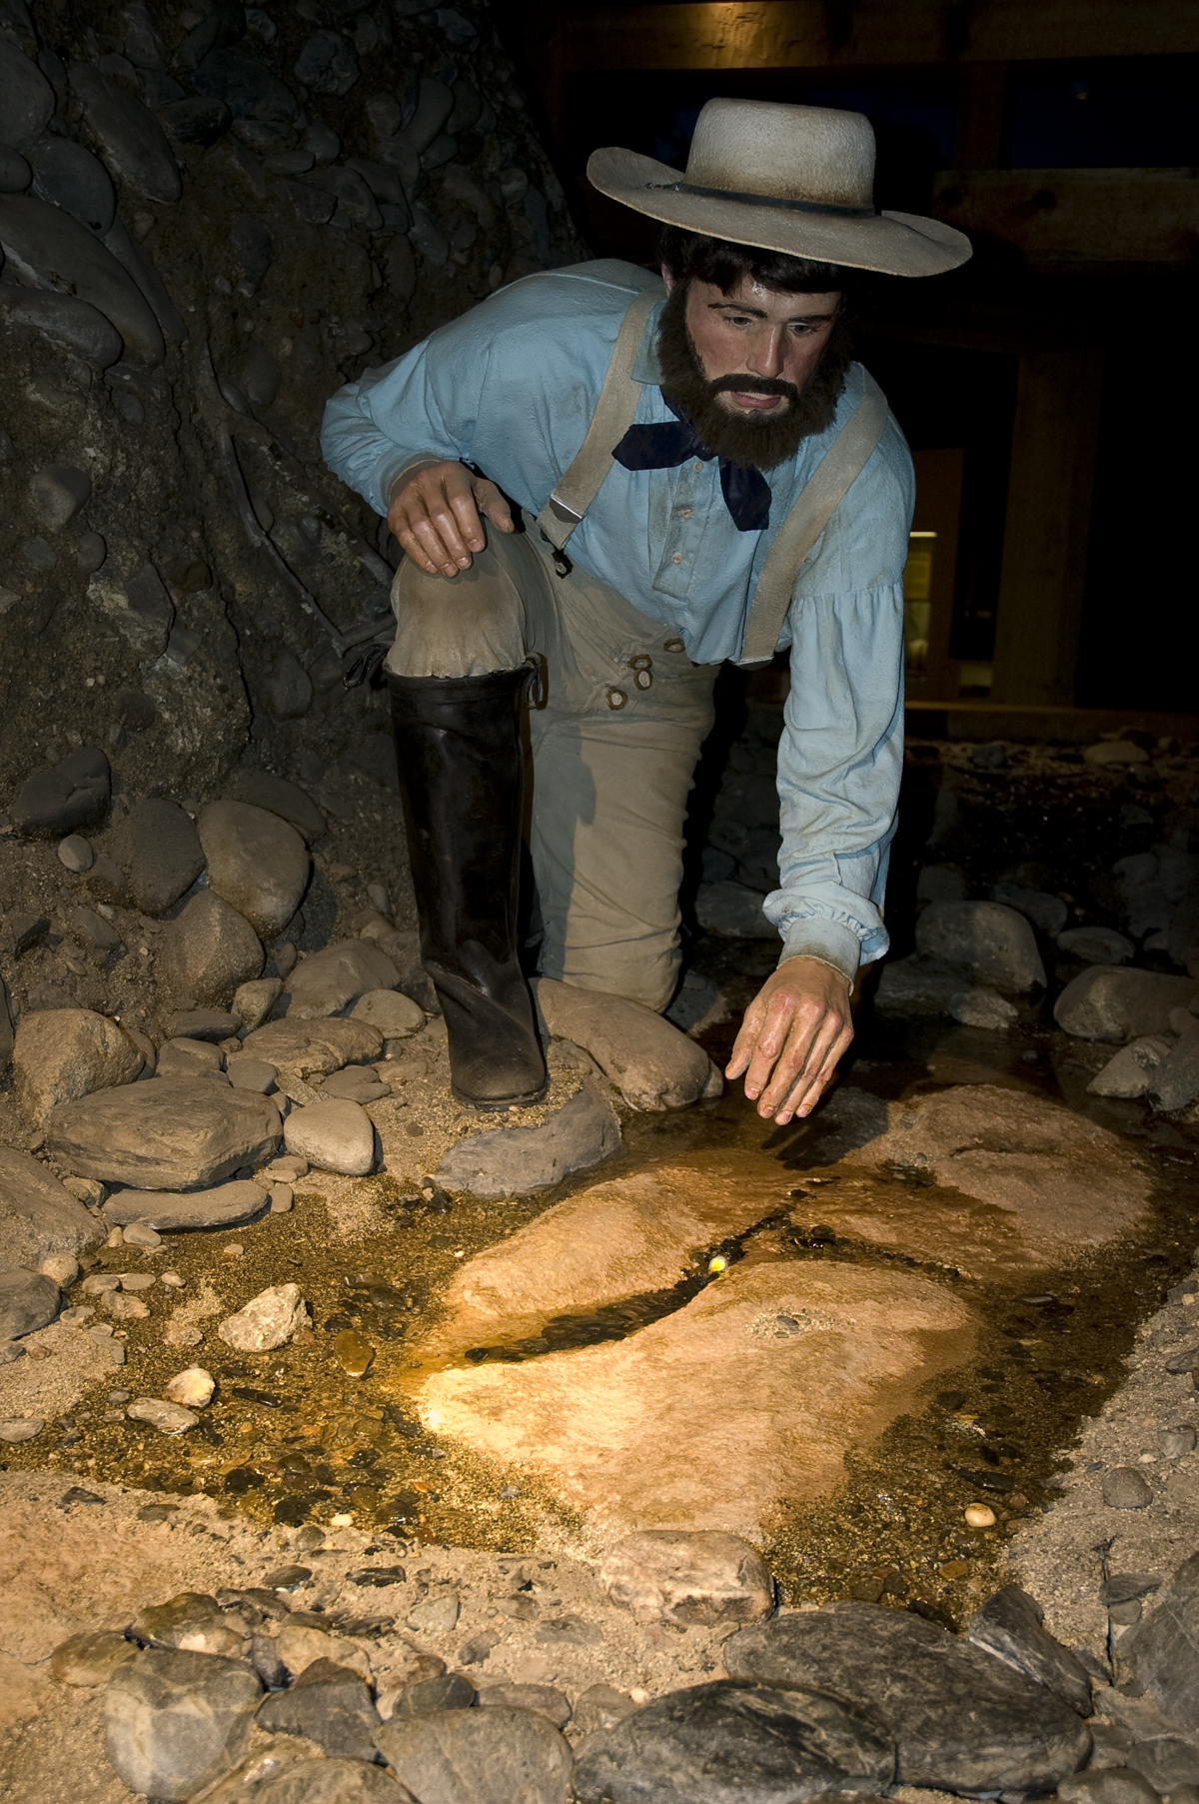
1898 Semi-Centennial California Gold Discovery William D. Hyder
ANA National Money Show
Sacramento 2011

Slide 2
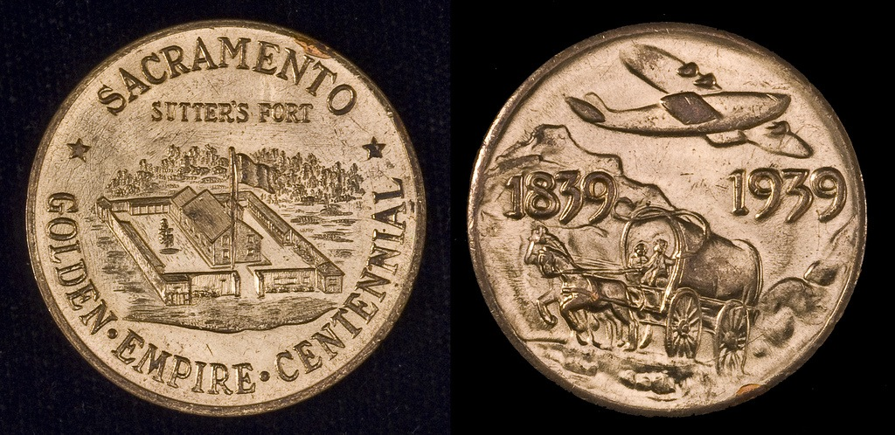
Swiss born John A. Sutter established a fort in Sacramento that became the destination for American immigrants.

Slide 3
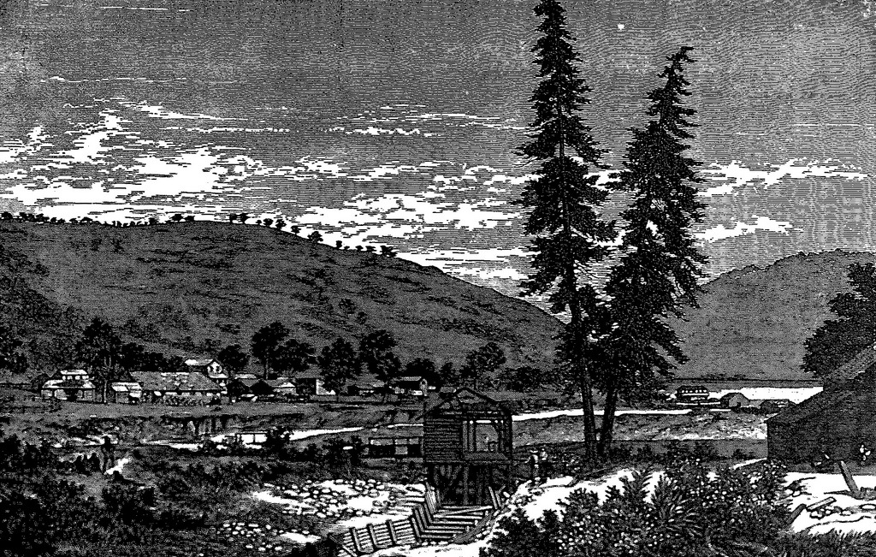
James W. Marshall contracted to build a sawmill at Coloma Flat to supply the growing community around Sutter's Fort.

Slide 4
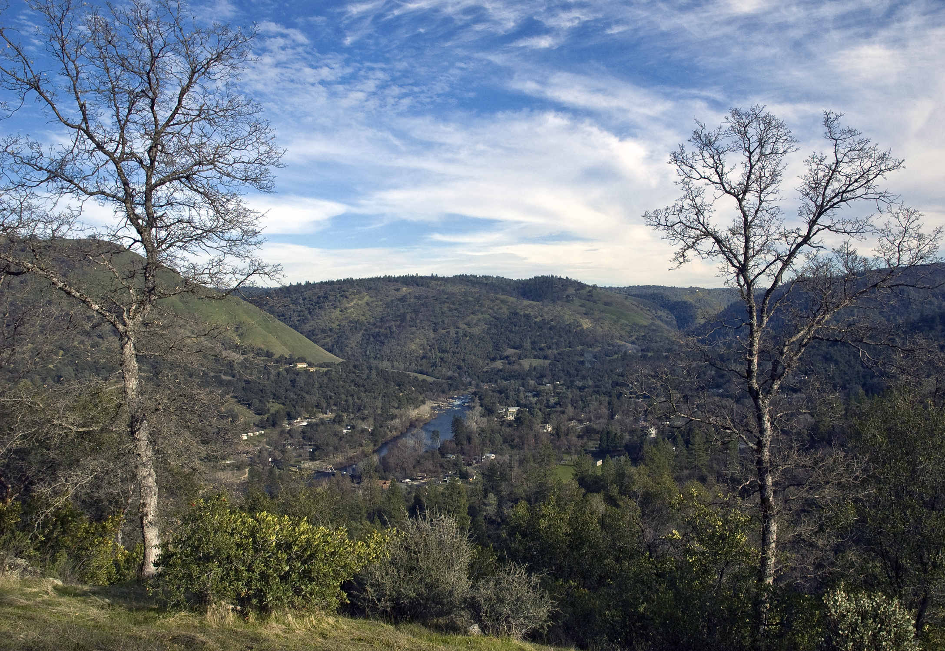
Coloma 2011

Slide 5
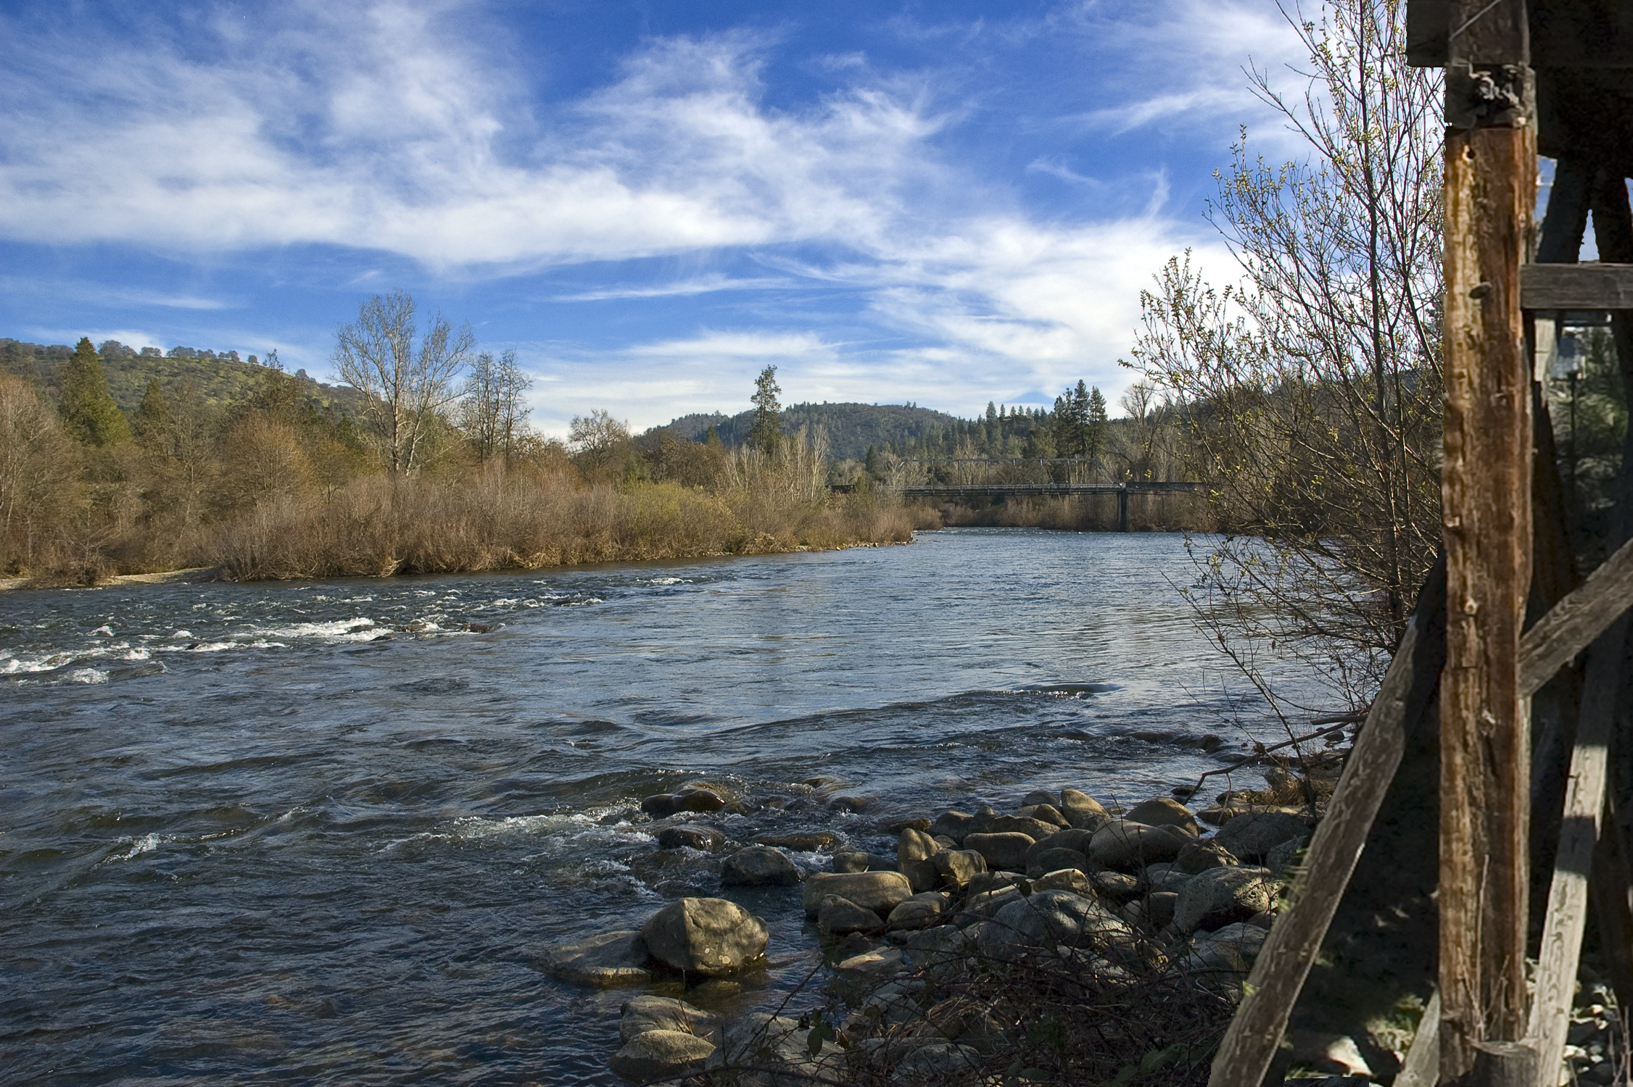
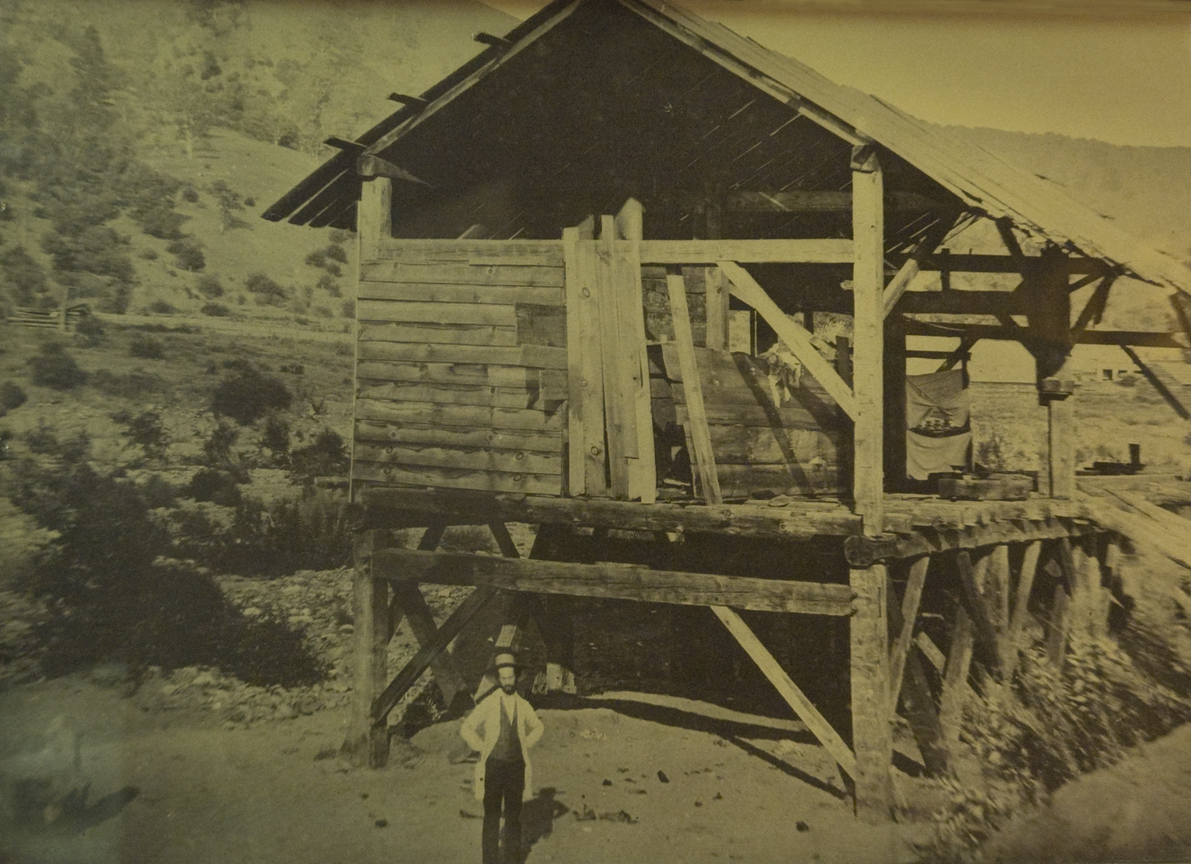
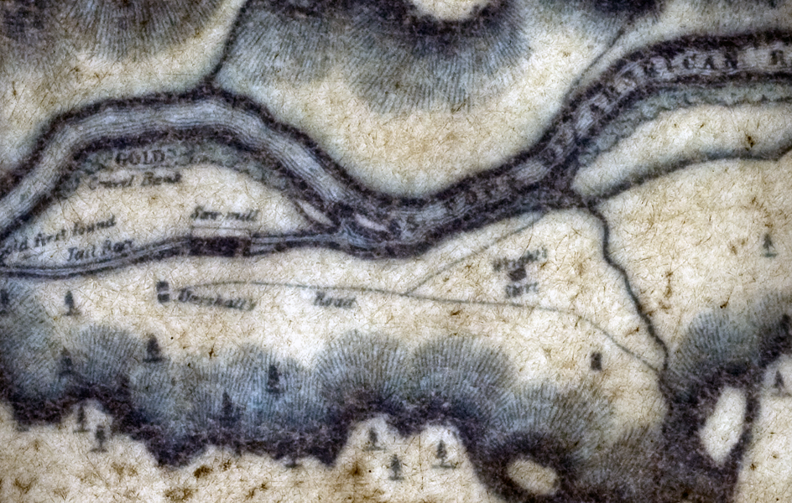
South Fork of the American River at the location of the saw mill.

Slide 6
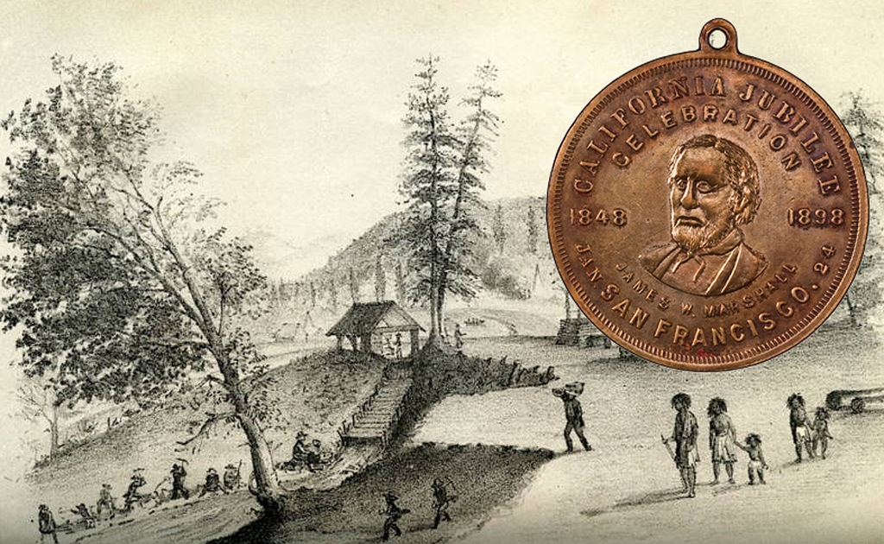
Monday morning, January 24, 1848, Marshall discovered gold nuggets while inspecting the newly finished mill race.

Slide 7
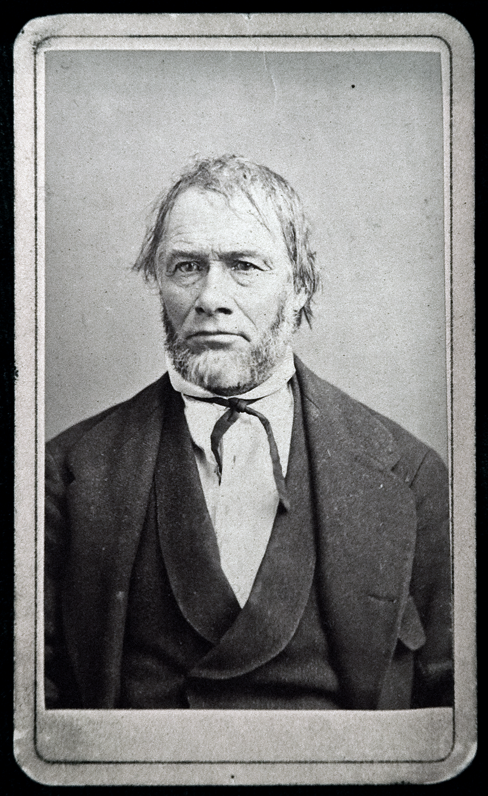
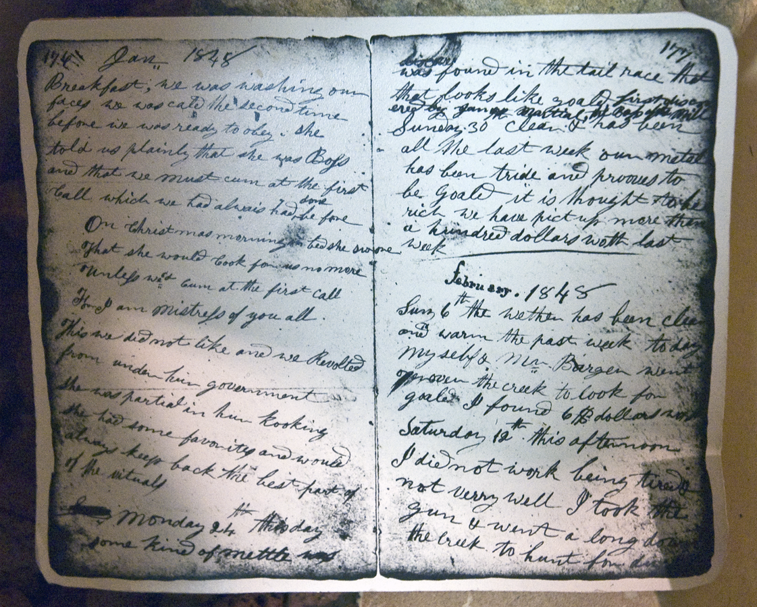
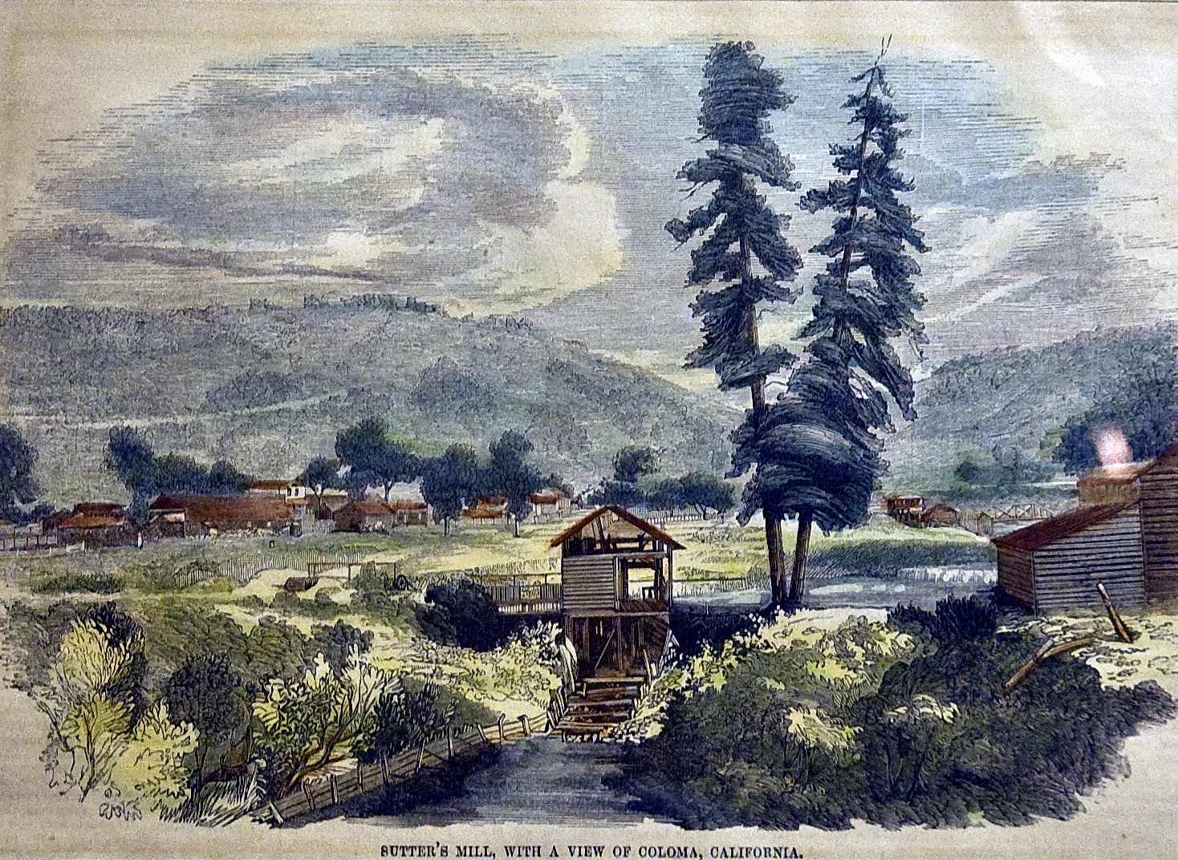
Bigler’s diary entry for January 24, 1848.
James W. Marshall
Illustration from Gleason's Pictorial Drawing Room Companion.

Slide 8
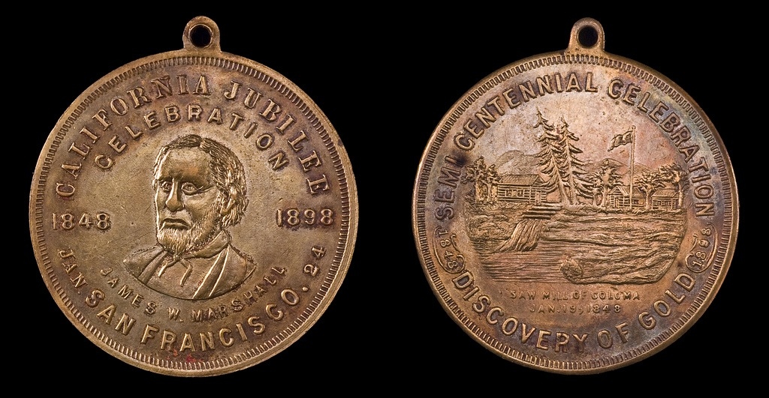
California’s Golden Jubilee Celebration
James Marshall Souvenir
Brass, 35 mm

Slide 9
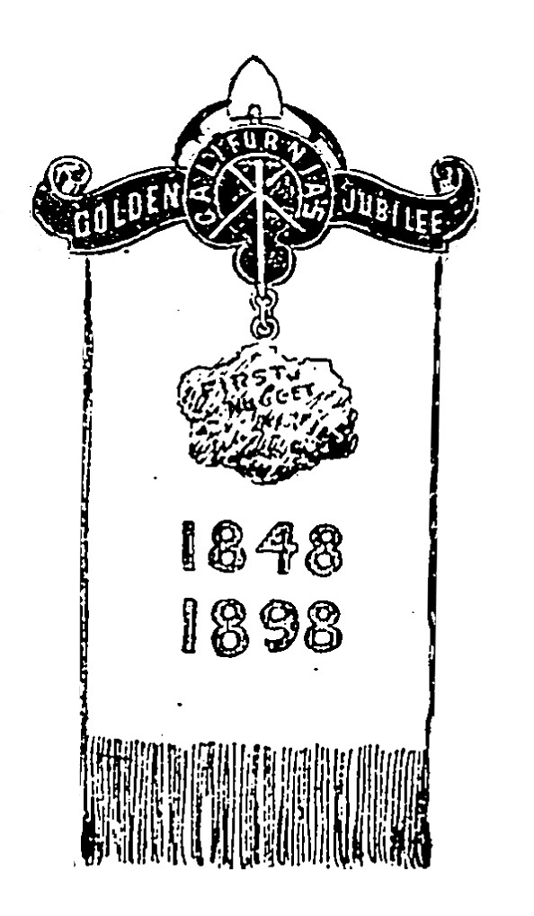
Walter Brunt, San Francisco printer and regalia maker, designed the official souvenir badge composed of a silk ribbon, pin hanger, and a facsimile of the first nugget found by Marshall.

Slide 10
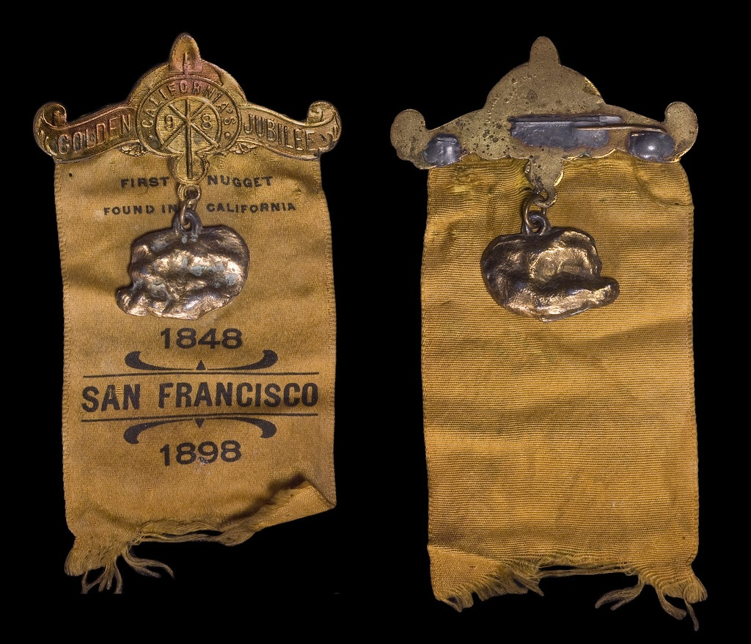
Produced by J.C. Irvine, SF. Brass and Silk, 54mm x 105mm Cost 10¢ to make, sold for 25¢, 1270 sold.

Slide 11
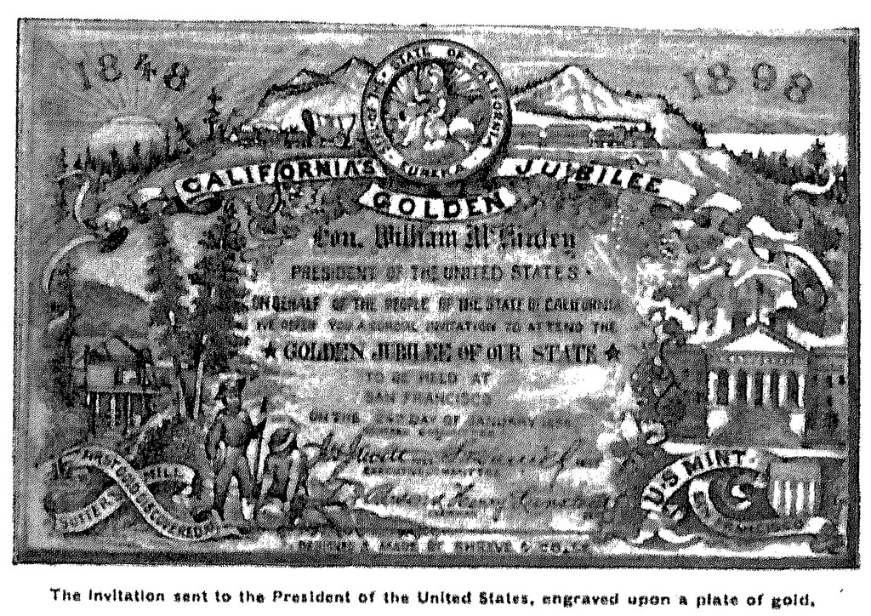
President McKinley received a solid gold invitation produced by Shreve & Co. Silvermiths of San Francisco.

Slide 12
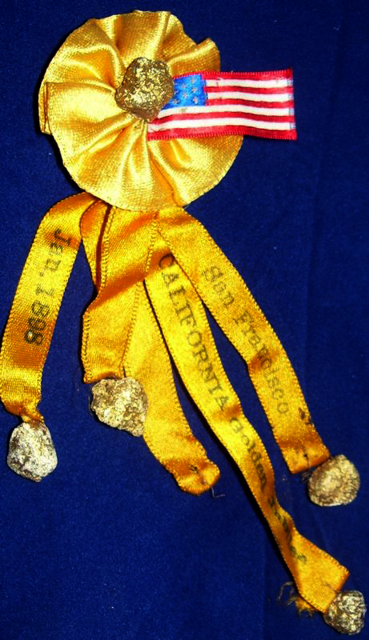
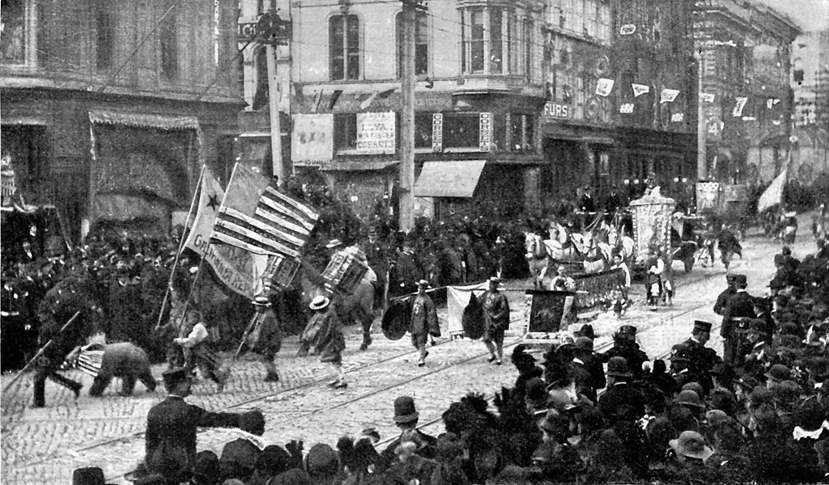
January 24, 1898, 7 AM, the city battery guns boomed out a welcome to the day, echoed by the guns at Fort Mason, Alcatraz, and Angel Island. A grand parade moved down Market Street at 10:45 AM.

Slide 13
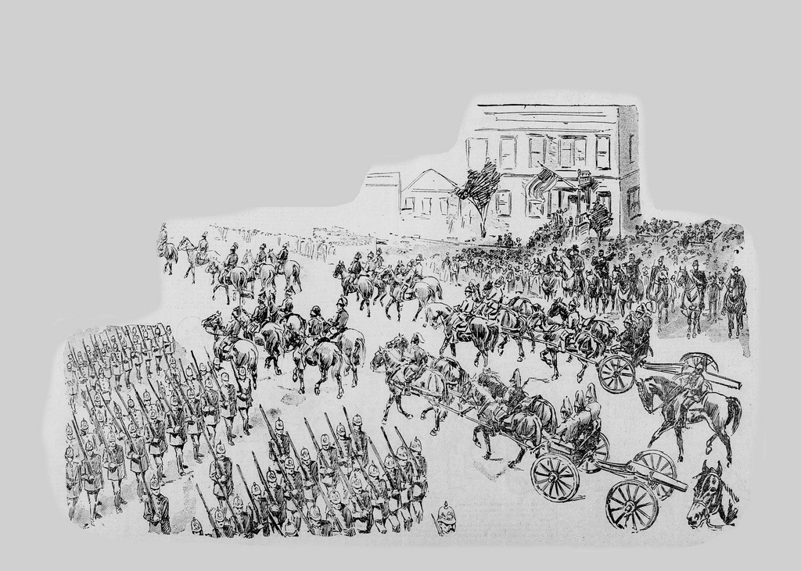
Chief of Police I.W. Lee led the mounted police, followed by Grand Marshall John F. Morse, followed by the U.S. Army Signal Corps to open the 5 mile procession.

Slide 14
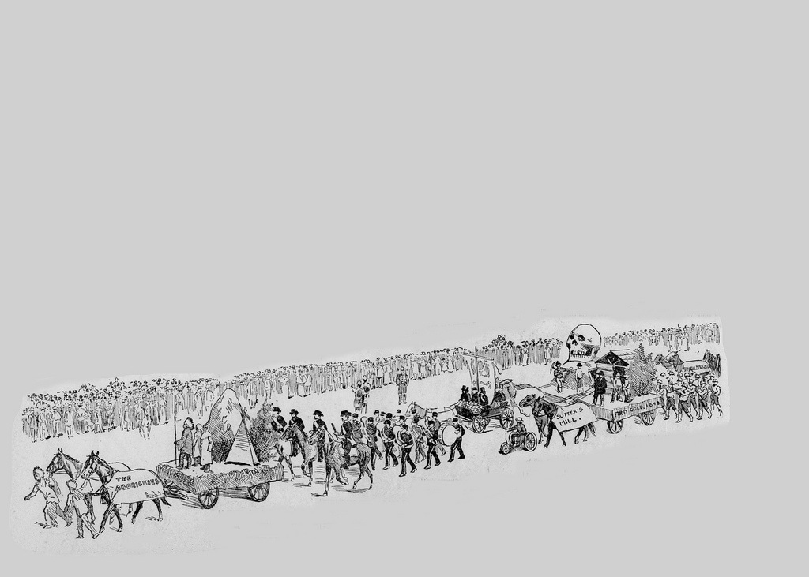
Society of California Pioneers followed the men present when the first nugget was found. The floats that followed told the history of California. The Aborigines. The National Guard. The California Miner's Association with a gilt skull representing the gold extracted from Calaveras County.

Slide 15
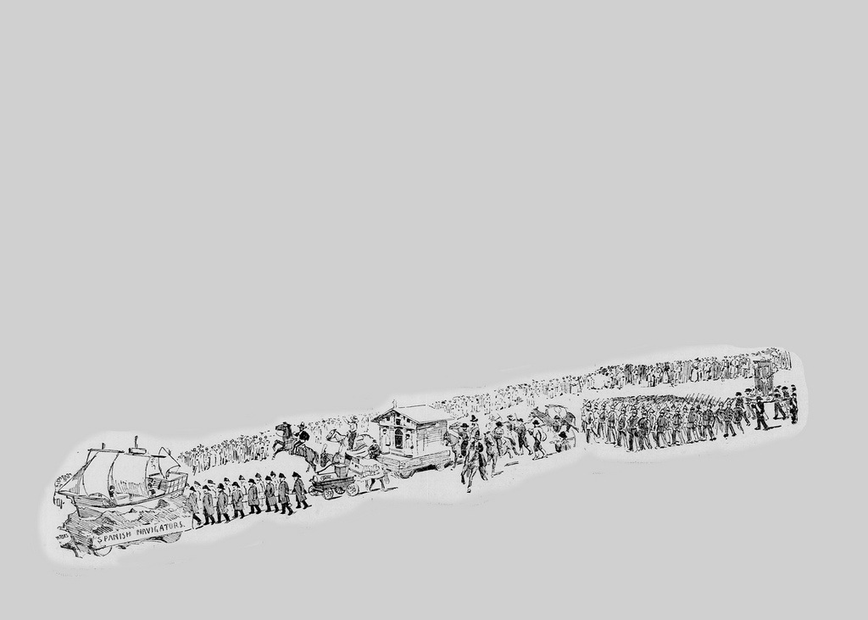
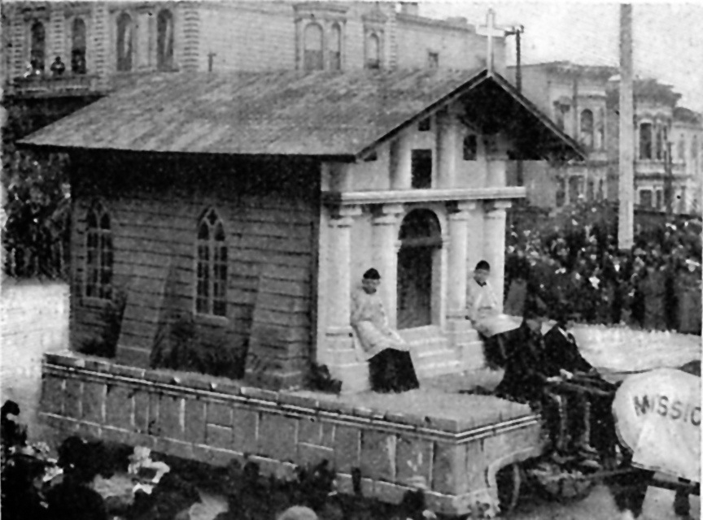
The Spanish Navigators commemorating Balboa, followed by the Exempt Firemen's Association and the oldest piece of fire equipment on the coast. Next came the Mission Delores float.

Slide 16
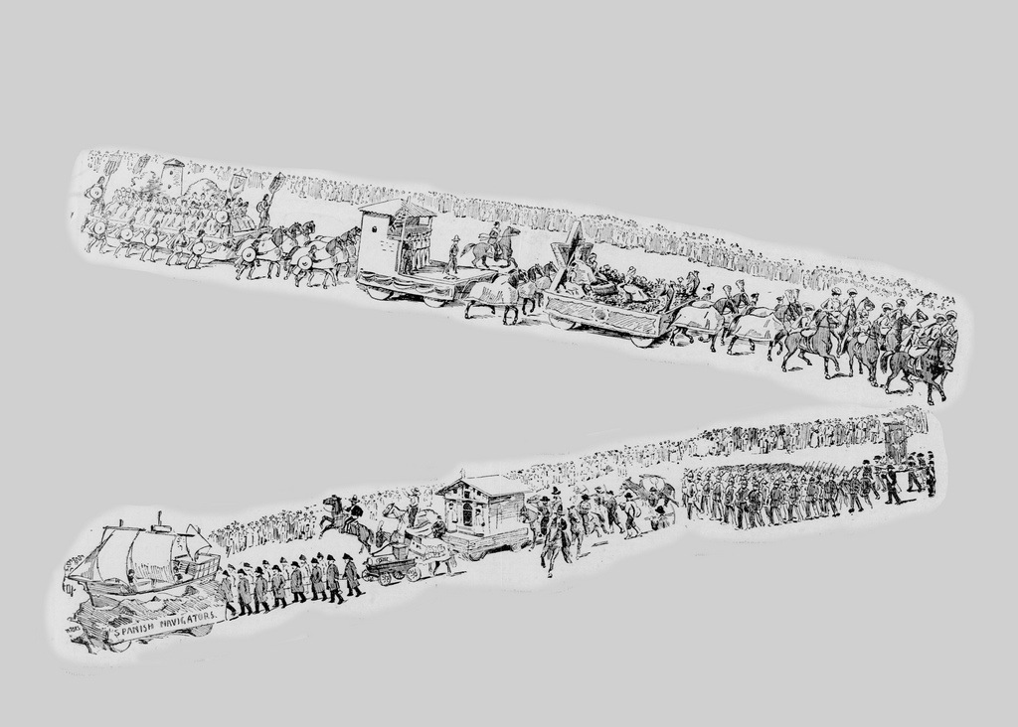

Slide 17
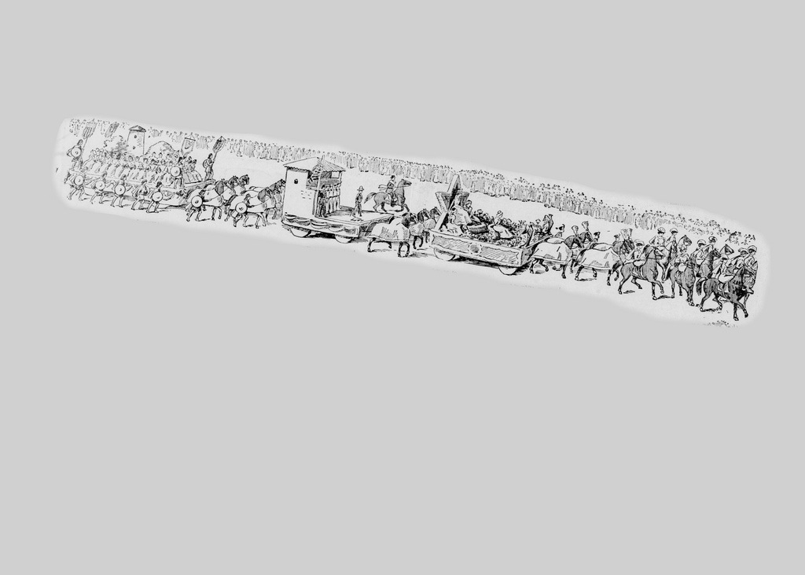
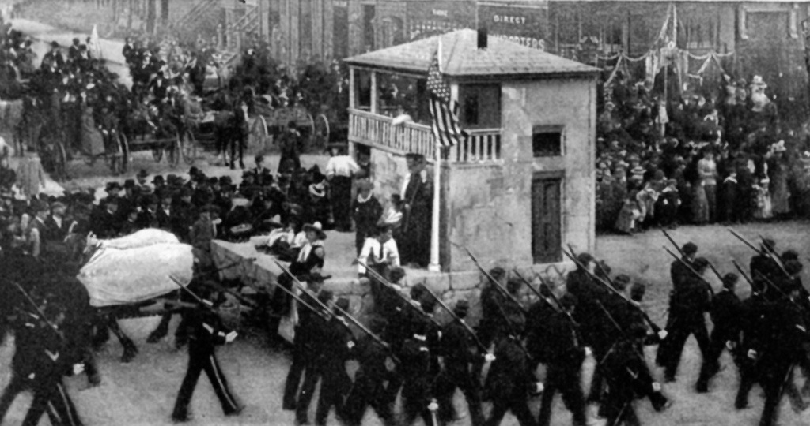
Raising the American flag at the Monterey Customs House.

Slide 18
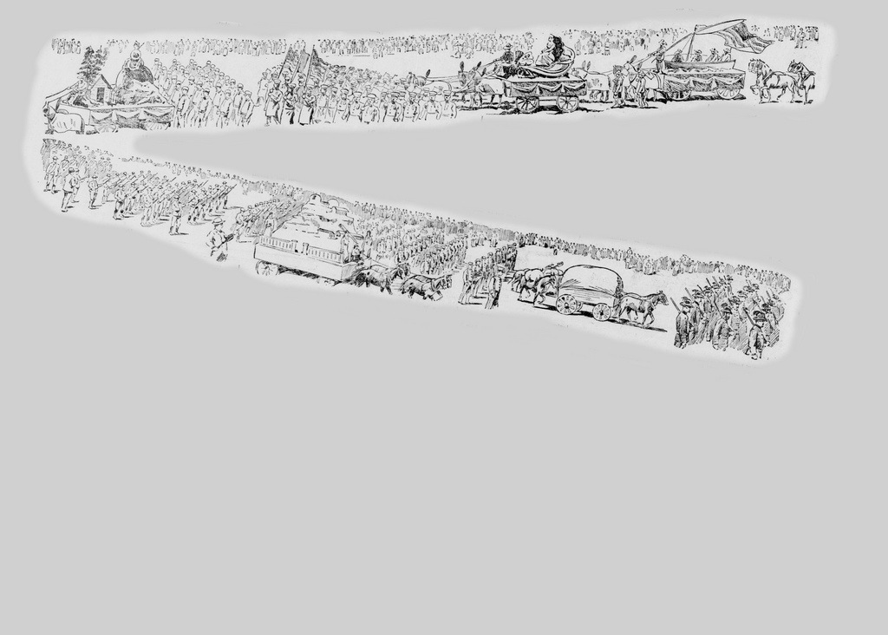
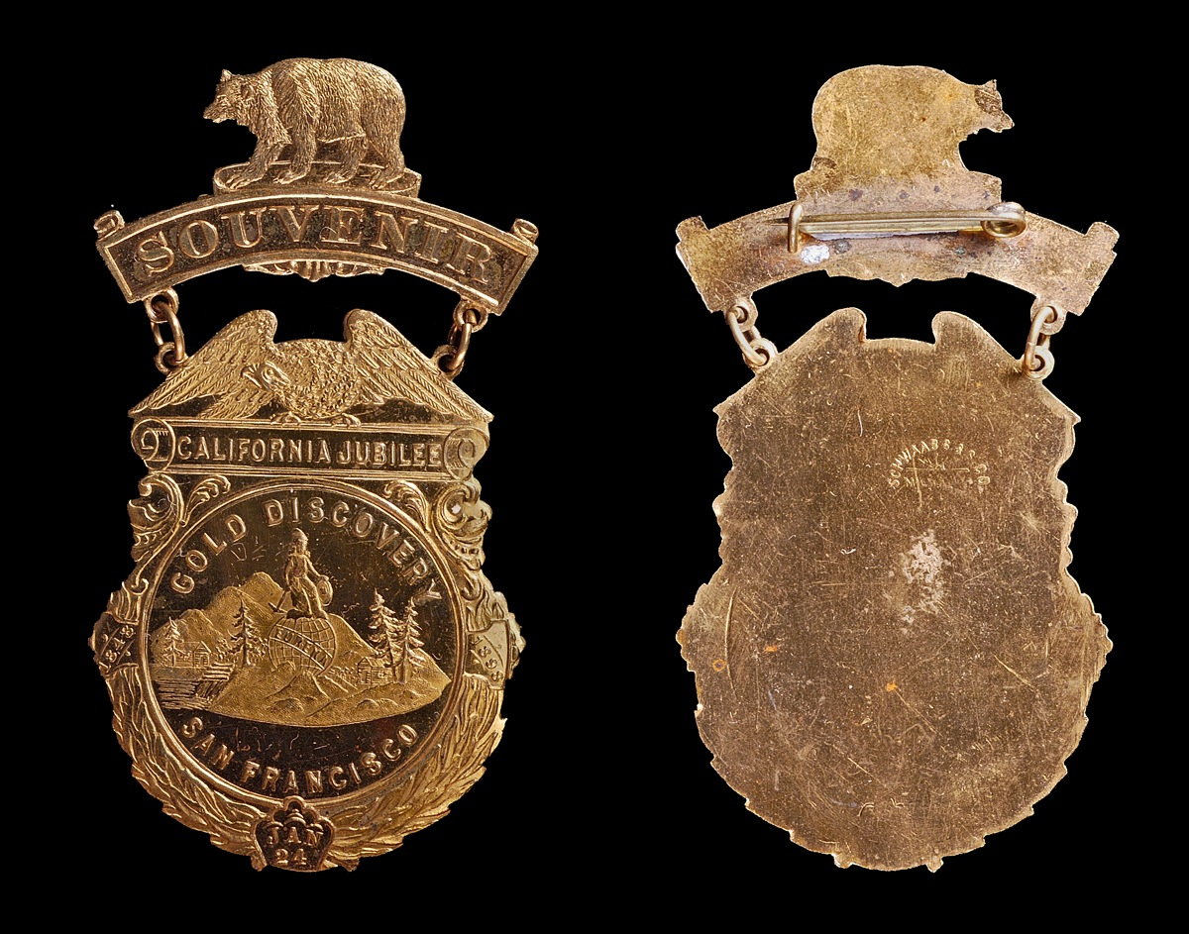
Minerva sitting atop a mountain of gold--parade float and souvenir badge.

Slide 19
Souvenir Badge Signed Schwaab Stamp & Seal
Gilt Brass, 69mm x 38mm

Slide 20
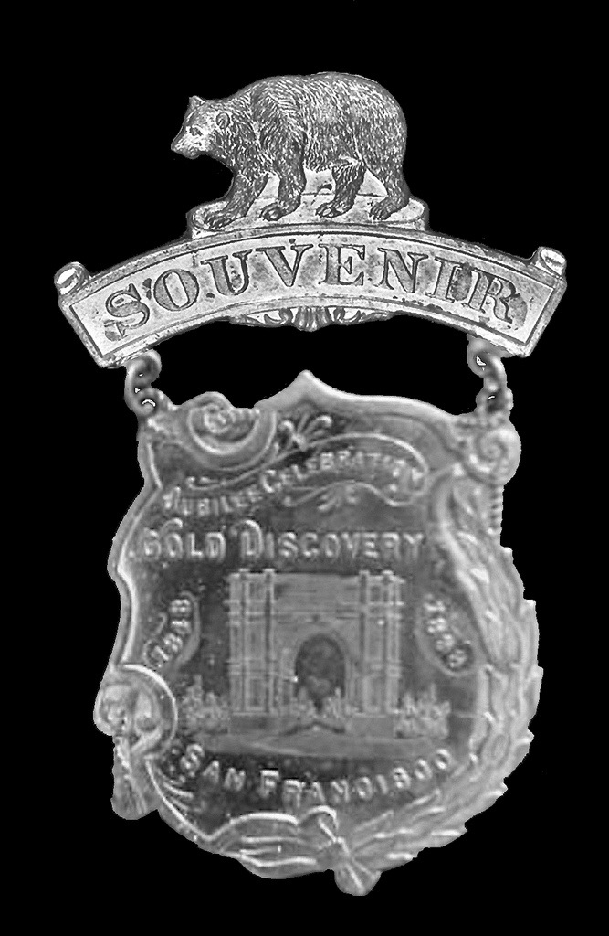
Souvenir badge by Schwaab Stamp & Seal showing the Grand Arch at the reviewing stand on Market St.
Gilt Brass, 51mm x 38mm

Slide 21
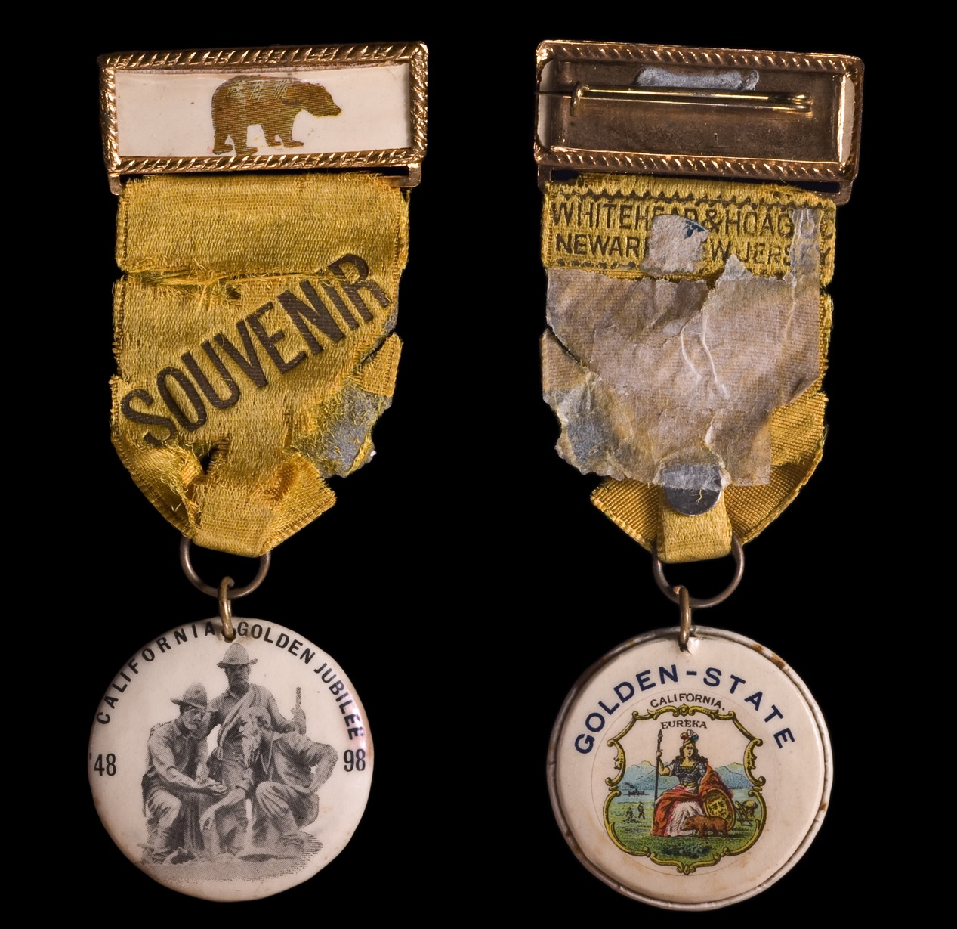
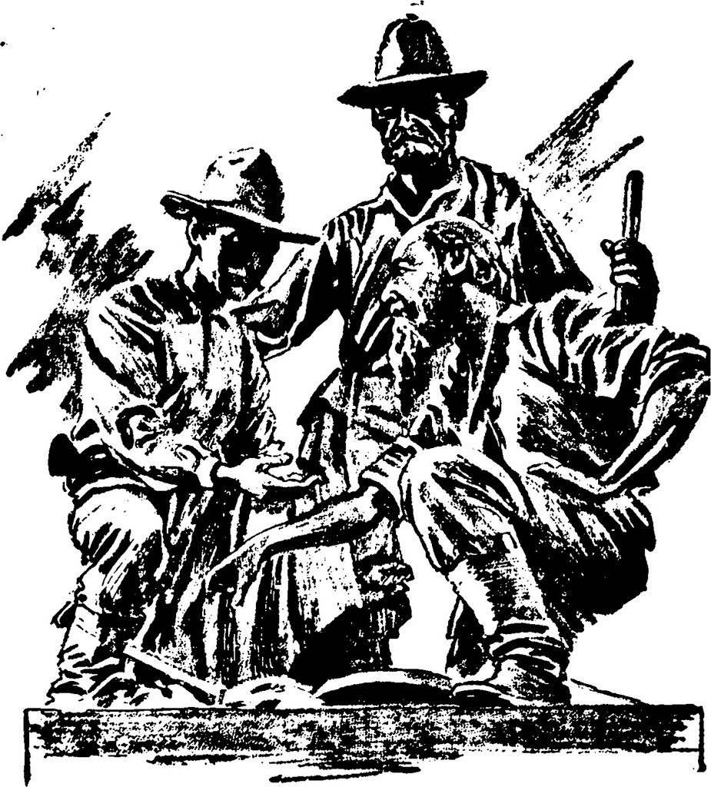
San Francisco Chronicle coverage featured an illustration of what appears to be a commemorative monument.
The same illustration appears on a celluloid badge produced by
Whitehead and Hoag Co.
Gilt-tin, cloth, and celluloid.
38mm x 92mm

Slide 22
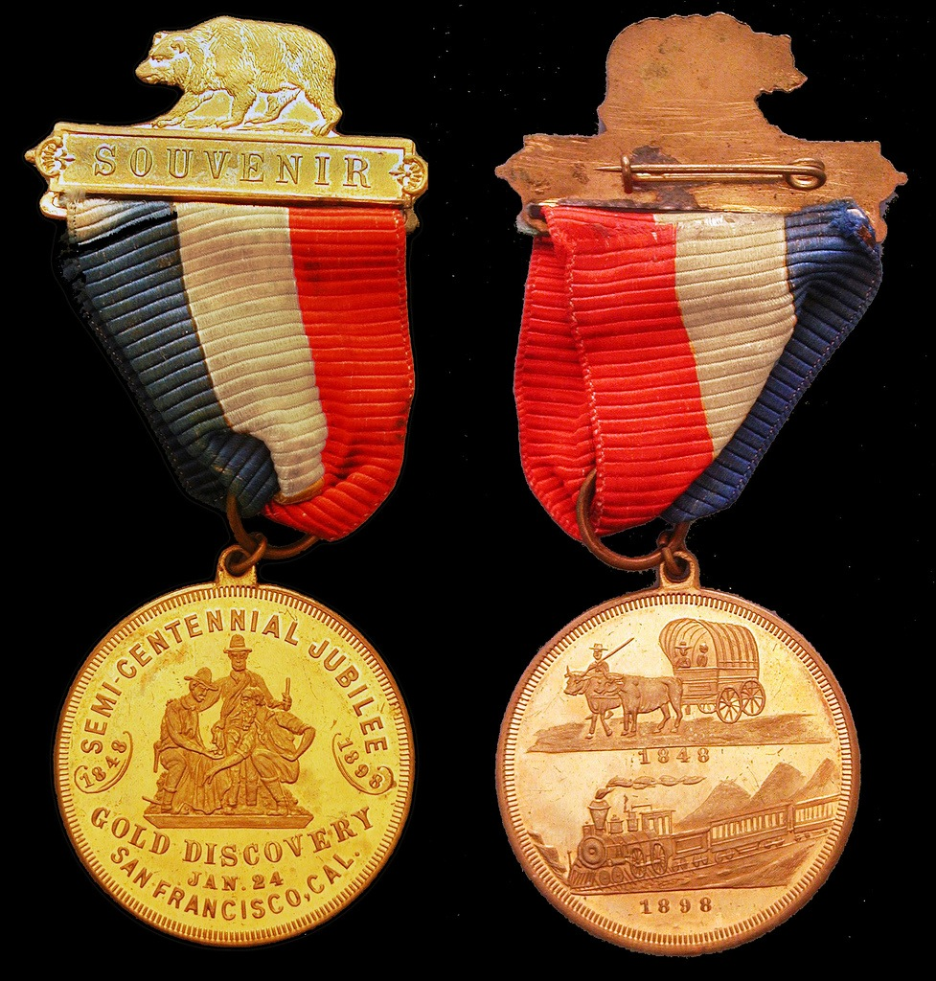
So-called dollar H&K 642 with blue-white-red ribbon and souvenir pin bar. Unsigned, but attributed to Schwaab S&S.
(Jeff Shevlin collection)

Slide 23
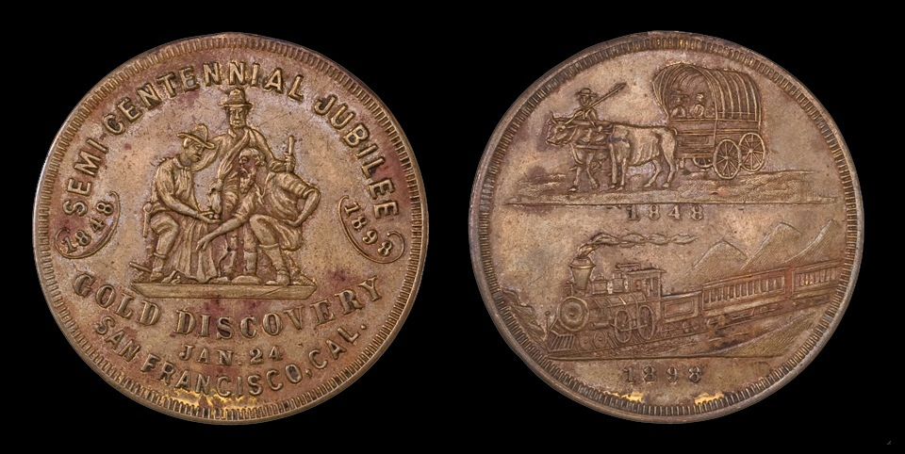
Most examples of H&K 642 appear to have the loop removed and the gilt layer has flaked off.
Gilt Brass, 35mm

Slide 24
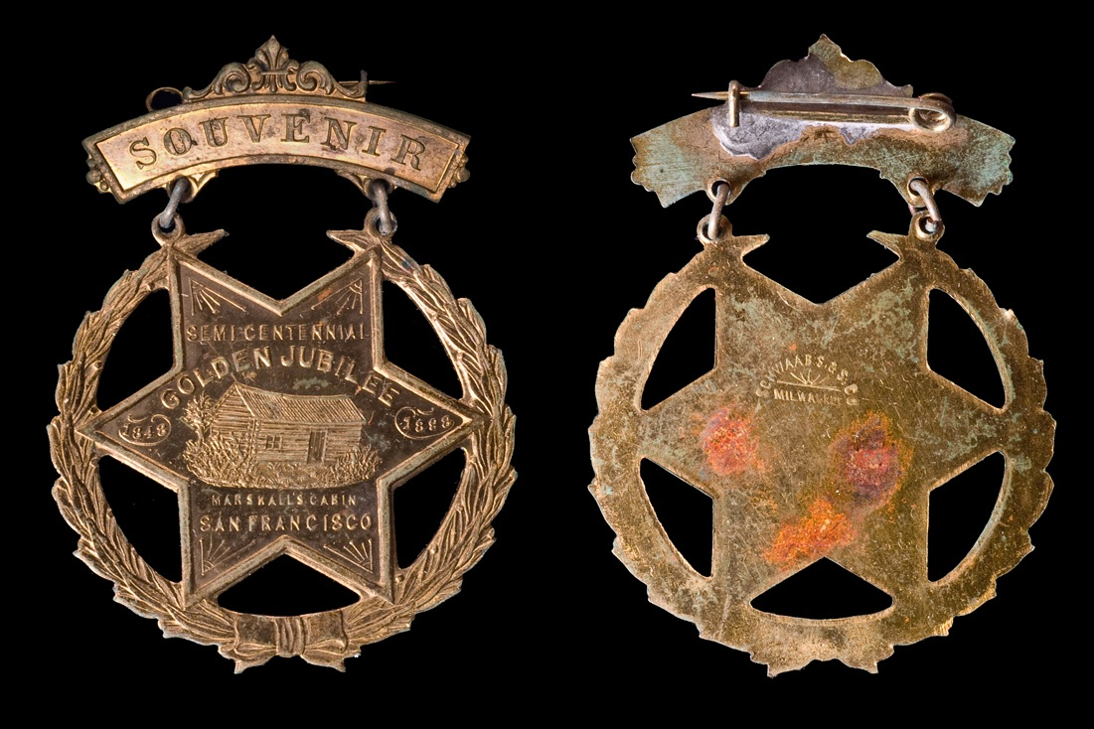
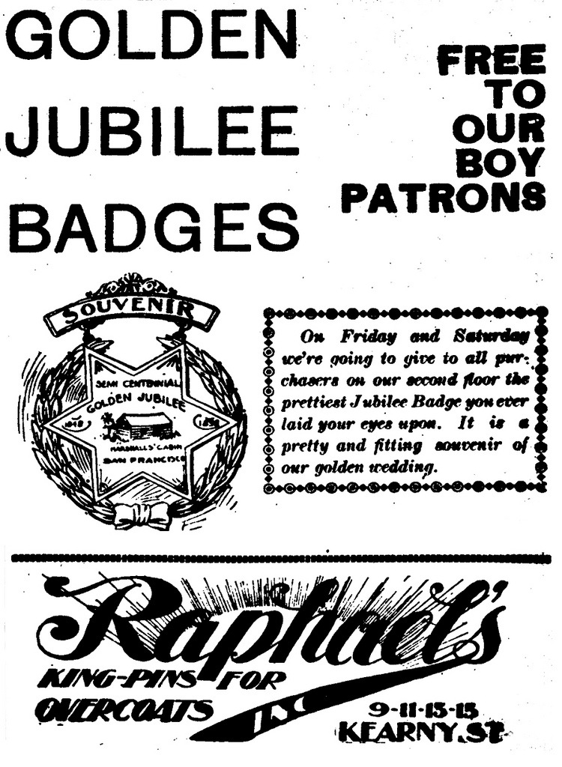
Souvenir Badge
Signed Schwaab Stamp & Seal
Gilt Brass, 43mm x 28mm

Slide 25
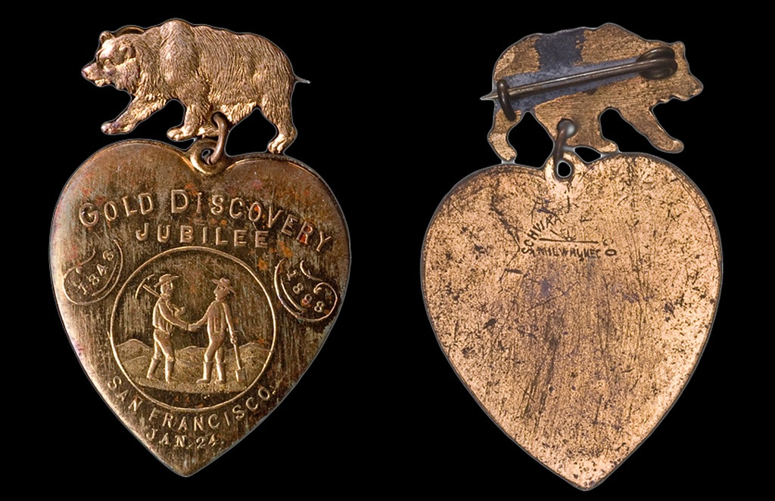
Heart Badge
Signed SCHWAAB S. & S. CO. / MILWAUKEE.
Gilt Brass, 43mm x 28mm.Gilt Brass, 43mm x 28mm

Slide 26
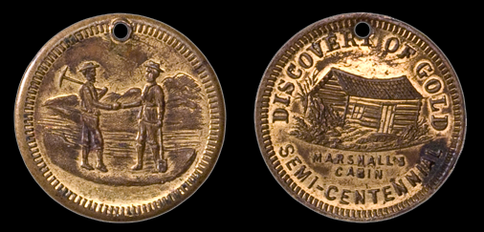
Medal featuring images from the previous two Schwaab badges.
Gilt Brass, 24mm

Slide 27
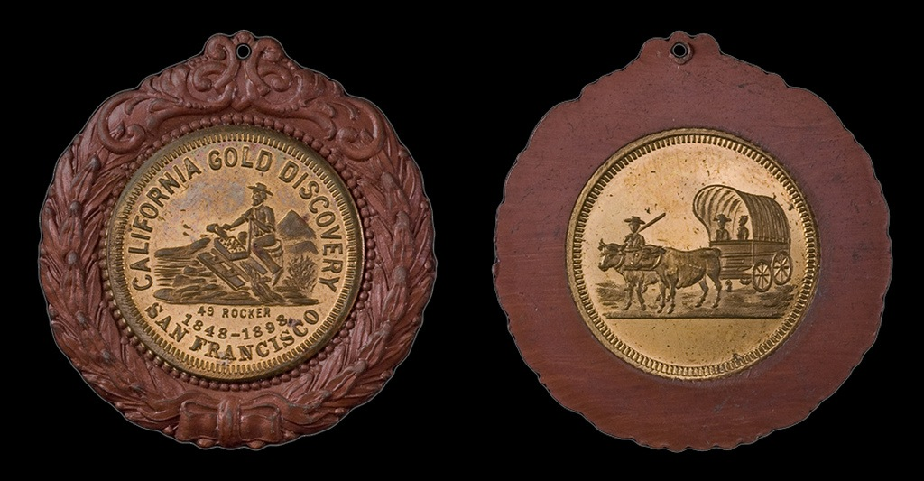
Schwaab?
Wreath with encased medal.
Wreath: Bronze, 37mm
Medal: Gilt Brass, 24mm

Slide 28
Schwaab?

Slide 29
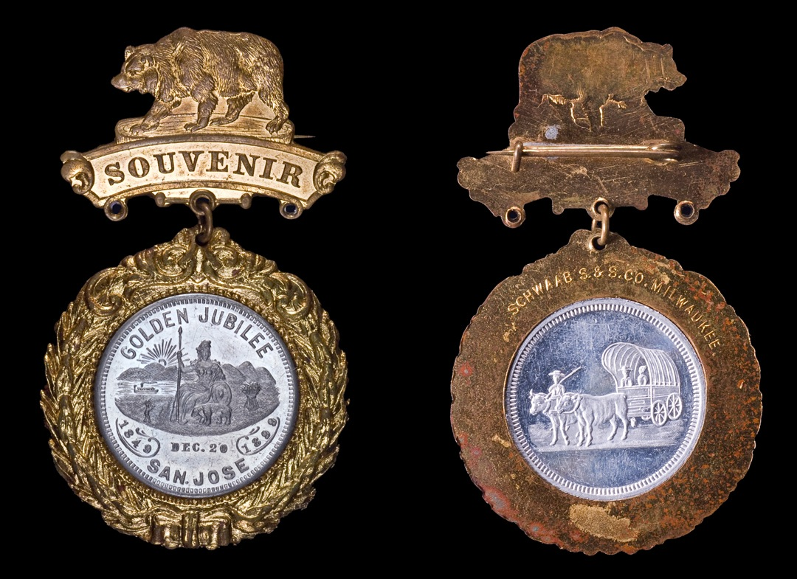
California's Golden Jubilee, San Jose
Schwaab Stamp & Seal
Wreath: Gilt brass, 37mm.
Medal: Aluminum, 24mm.

Slide 30
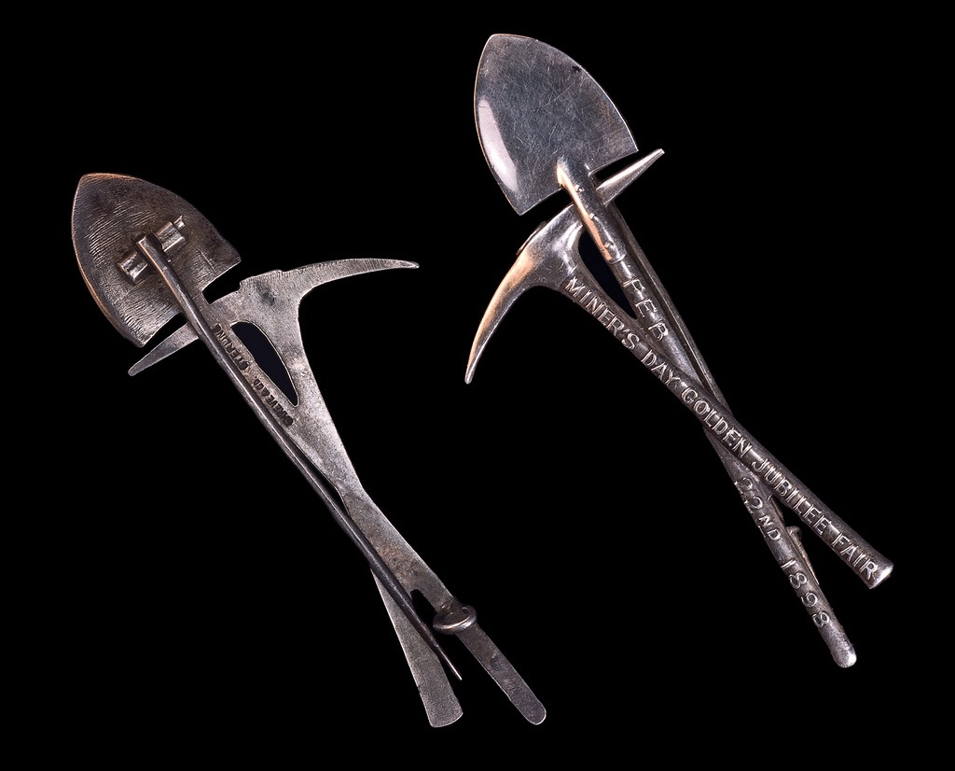
Golden Jubilee Mining Fair
The pick handle inscription reads, MINER’S DAY GOLDEN JUBILEE FAIR; the shovel handle, FEB 22ND 1898. The reverse incuse lettering, SHREVE & CO. STERLING.
Silver, 78mm x 35mm

Slide 31
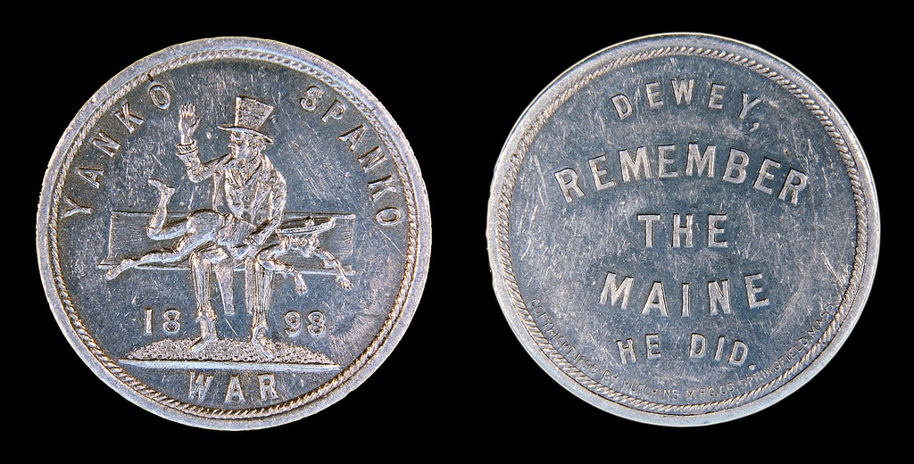
Why don't we remember the Mining Fair?
Following a week of festivities, balls, and grand dinners, the Golden Jubilee Mining Fair opened in the city’s Mechanics Pavilion for a five week run. The celebrations might have made a bigger mark on California’s history were it not for the explosion on the U.S.S. Maine in Havana Harbor on February 15. American cries to “Remember the Maine” overshadowed most other events of 1898.

Slide 32
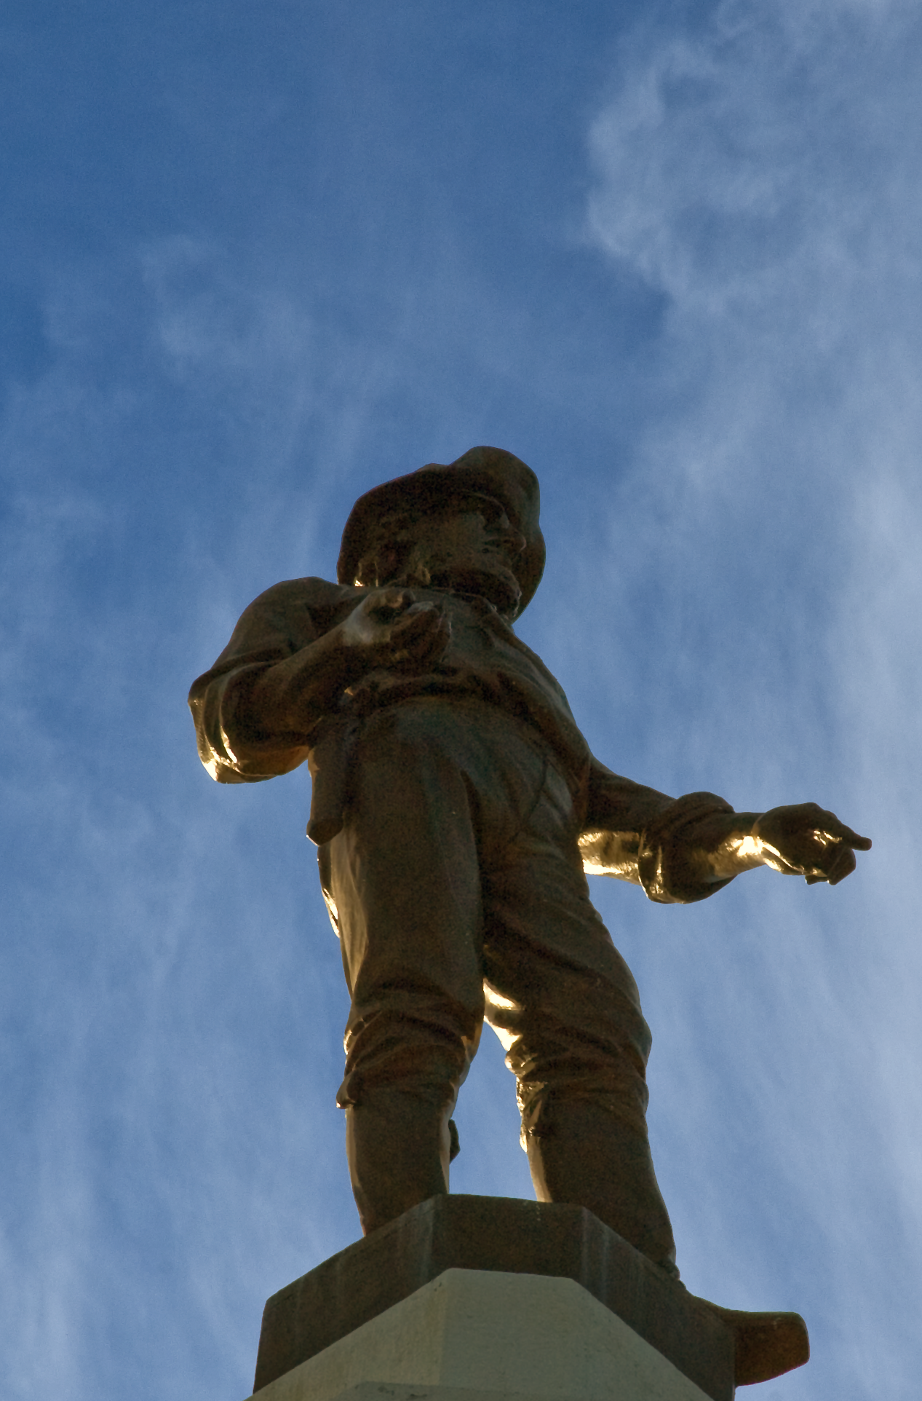
References:
“California’s Day of Jubilee.” San Francisco Chronicle. January 24, 1898. Pg. 10.
Official Souvenir of California’s Golden Jubilee Held at San Francisco. 1898.
California Golden Jubilee Committee, San Francisco.
The San Francisco Call. January 25, 1898.
Brown, James S. Life of a Pioneer Being the Autobiography of James S. Brown. George Q. Cannob & Sons, Salt Lake City. 1900.
Casper, Thomas. “Badger State Badge Maker,” TAMS Journal. 19(6):232-235. December 1979.
Fitch, George H. “California’s Golden Jubilee,” Harper’s Weekly. XLII(2147):148. February 12, 1898.
Hibler, Harold E., and Charles V. Kappen. So-Called Dollars: An Illustrated Standard Catalog. 2nd Edition. Coin & Currency Institute, Clifton. 2008.
Hyder, William D. “San Francisco Exonumia and 1898 Golden Jubilee,” TAMS Journal. 50(3):67-76. May 2010.
Lavender, David. California: Land of New Beginnings. Harper & Row, New York. 1972.

