Slide 1
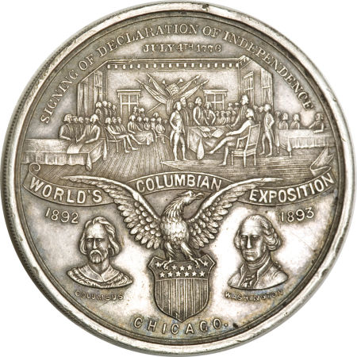
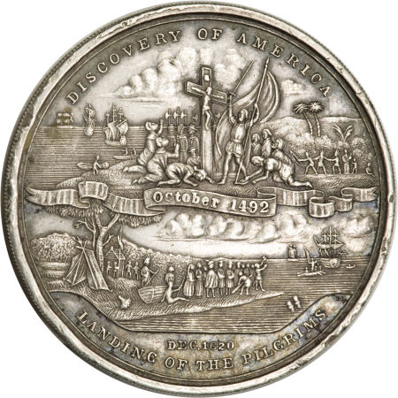
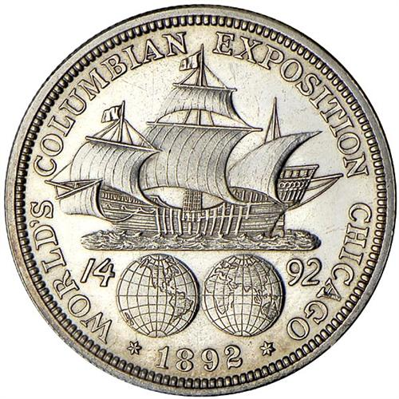
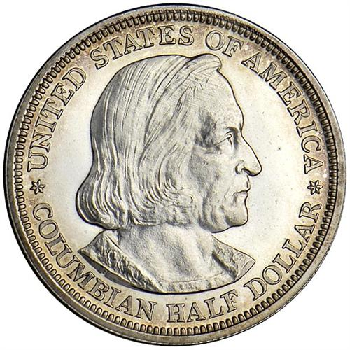
Exhibitions:
Associated “Early U.S. Commemorative”
Coins And “Exonumia”
Obv
Rev
1892 World’s Columbian Exposition Half Dollar
Proof 61
So-Called Dollar
Obv HK-156 (R-6) Silver
“Declaration of Independence Dollar”
1893 World’s Columbian Exposition

Slide 2
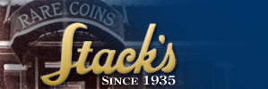
Heritage Auction Galleries

Slide 3
The First Four “American” Expositions Commemorated in U.S. Coin:
1893 World’s Columbian Exposition (Held in Chicago, Illinois)
1904 Louisiana Purchase Exposition (Held in St. Louis, Missouri)
1905 Lewis and Clark Centennial Exposition (Held in Portland, Oregon)
1915 Panama-Pacific International Exposition (Held in San Francisco, California)
Other Expositions which could be included are:
1900 Paris (France) Exposition (“1900” Lafayette Dollar)
1926 Sesquicentennial of American Independence (1926 Half Dollar and $2 ½ Gold Piece)
1935, 1936 California-Pacific International Exposition (1935-S, 1936-D Half Dollars)

Slide 4
“Early” Commemorative
Coins Depict:
Places, Events, People
Per the cover of Arlie Slabaugh’s book
“United States Commemorative Coins”:
“The Drama Of America As Told By Our Coins”

Slide 5
So-Called Dollars Are:
Medals of “Near Dollar” Size (33-45 mm) of a Commemorative or
Exhibition Nature And They Are Often Times Symbolic of Industry, Culture, Philosophy
And Progress
A Few Were Minted by the U.S. Mint
(Many Times on Location of the Event!)
But Most Were Struck by Private Enterprises
Rarity Ratings:
R-1 >5000 known
R-2 2001-5000 known
R-3 501-2000 known
R-4 201-500 known
R-5 76-200 known
R-6 21-75 known
R-7 11-20 known
R-8 5-10 known
R-9 2-4 known
R-10 1 known (unique)

Slide 6
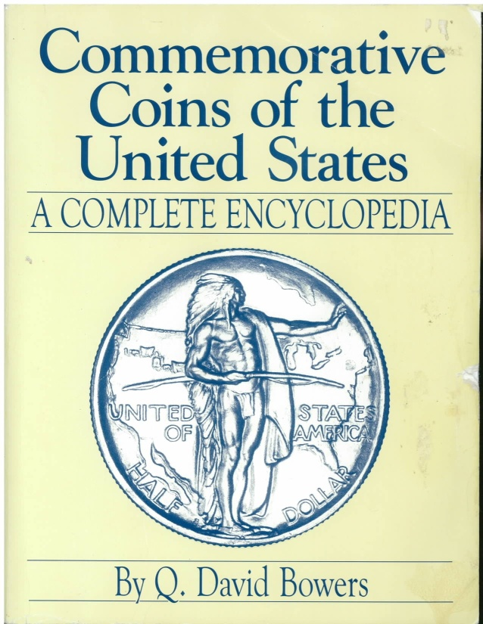
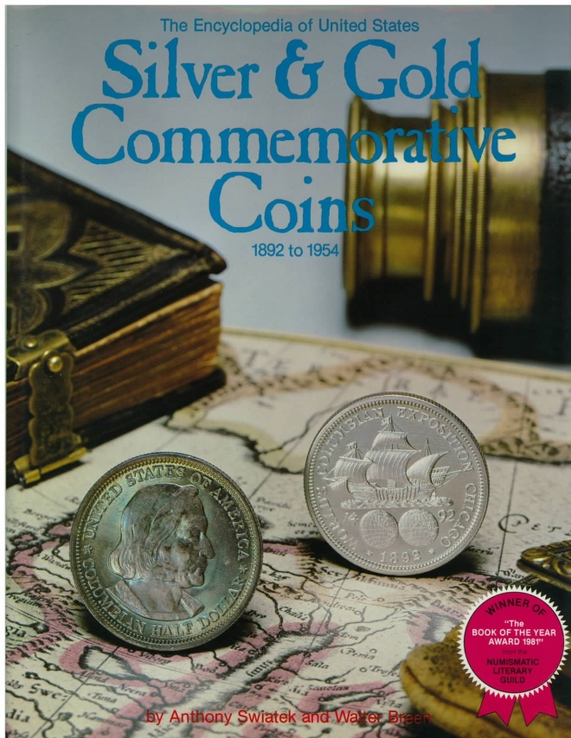
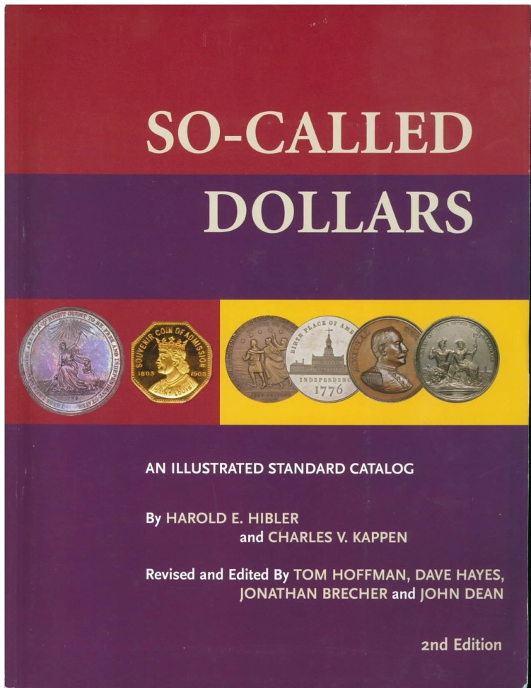
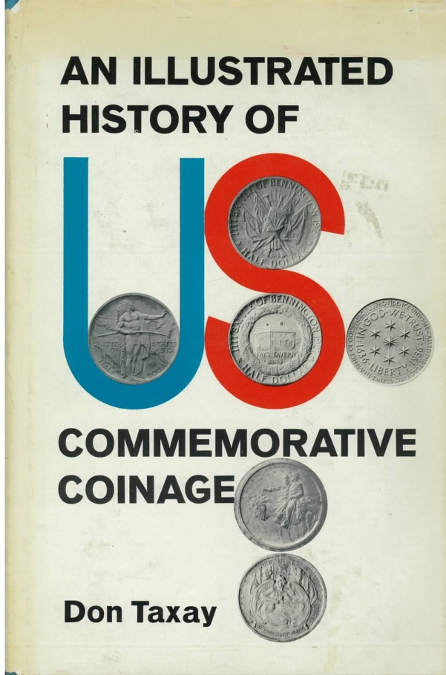
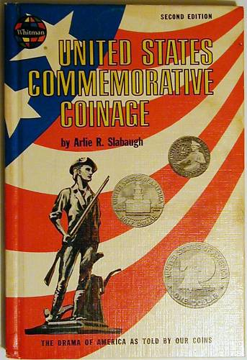
Published 1992
Published 1981, 1990
2008 (2nd) Edition by Hibler & Kappen
Published 1962, 1975
Published 1967

Slide 7
1893 World’s Columbian Exhibition:
Celebrated the 400th anniversary of Columbus’s landing in the new world
Held near Chicago and built on over 600 acres along the shores of Lake Michigan
All states and all countries were invited to participate;
All states and territories were represented and 50 countries took part
36 states built buildings and 17 countries built structures
The total number of exhibits exceeded 50,000
Electricity was fairly new and put to use for “lavish illumination”
Approximately 27,500,000 attended
Three U.S. Commemorative Coins were issued
>80 So-Called Dollars/Medals were distributed
Other medals, tokens etc. were also distributed or sold
(Nathan Eglit in His Book “Columbiana” Lists >600 Exhibition Items
Lots of stuff to collect!

Slide 8
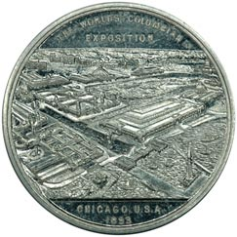
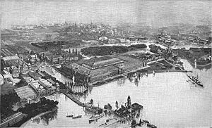
“Bird’s Eye View Dollar”
HK-167, R-5
Aluminum
Photo by John Raymond
Aerial View of the 1893 Columbian Exposition

Slide 9
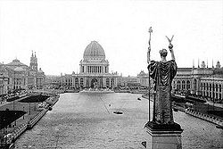
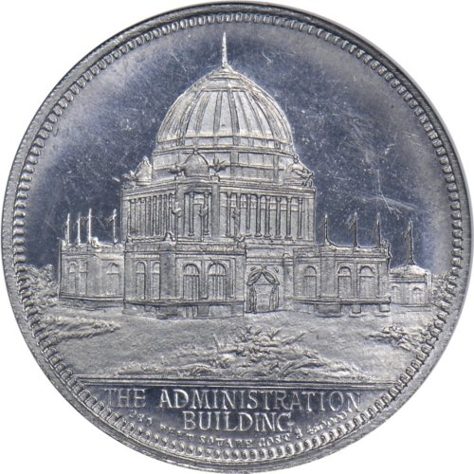
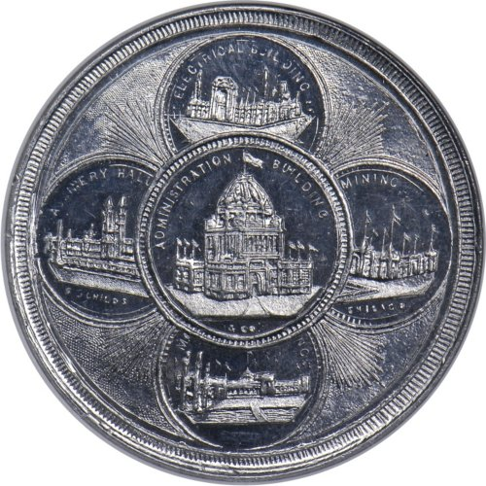
Administration Building
HK-177a Obv,, Aluminum, R-5, MS-62
HK-205 Rev., Aluminum, R-6, MS-63 PL

Slide 10
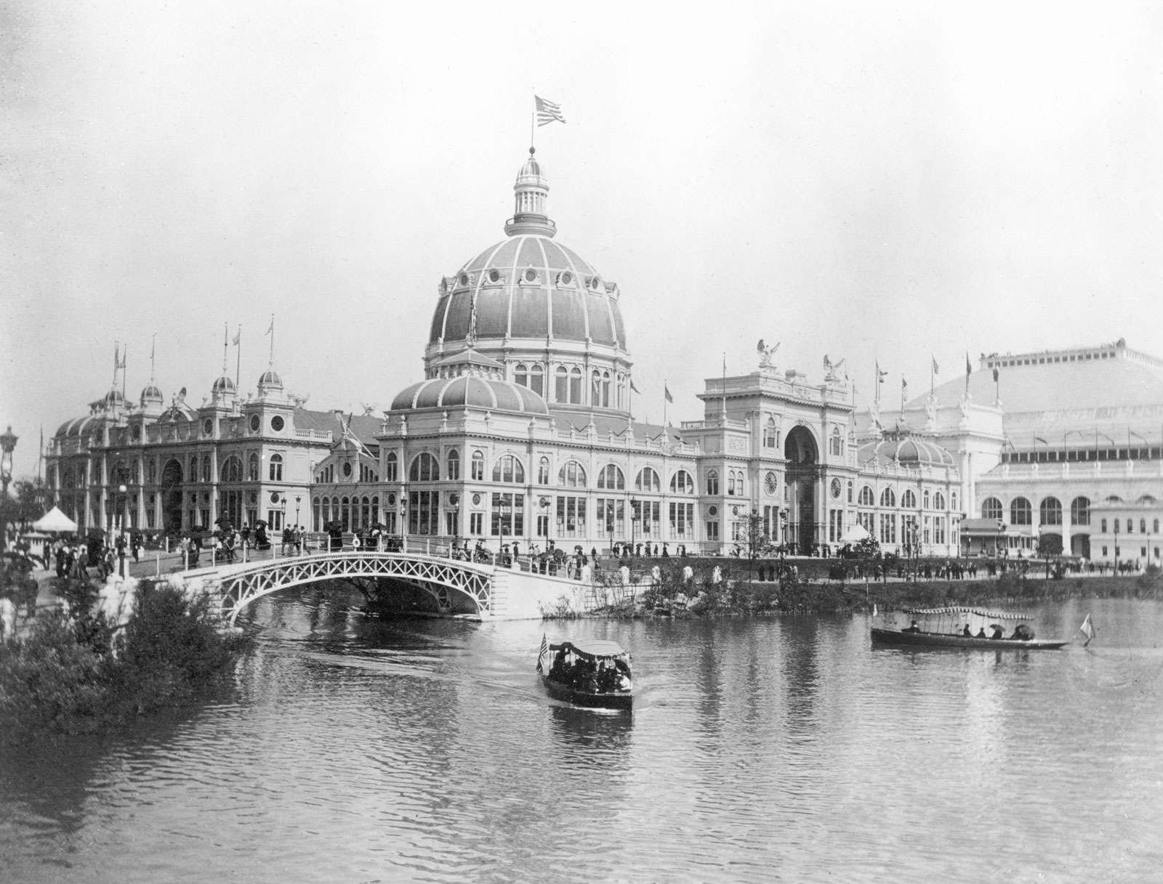
U.S. Government Building
HK-154 Obv. Brass, R-2, MS=62
The “Official” Medal Stuck at the Mint Exhibit
HK-154, Rev, Brass, R-2, MS-62

Slide 11
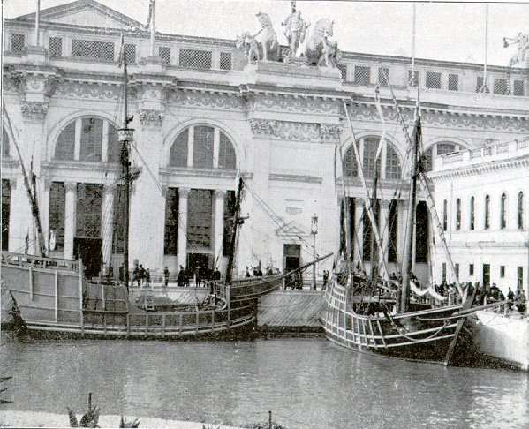
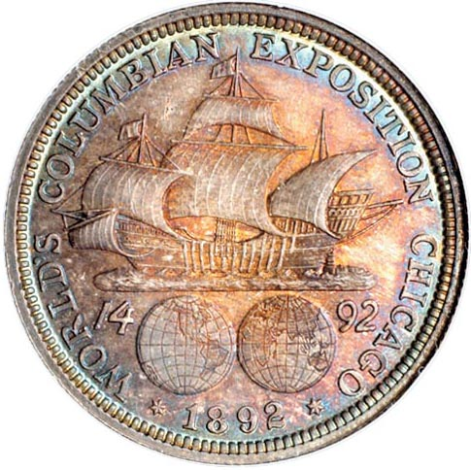
Rev 1892 World’s Columbian Exposition Commemorative
Half Dollar (MS-66 PL)
Replicas of Columbus’s ships built by Spain, Santa Maria on left

Slide 12
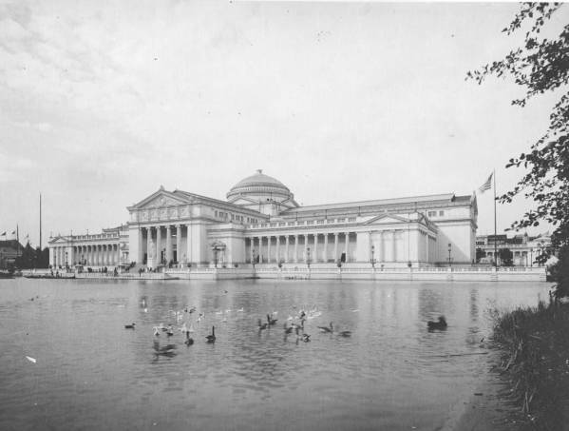
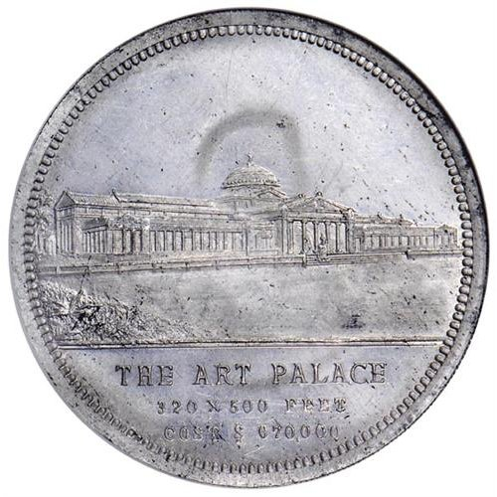
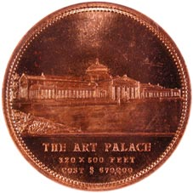
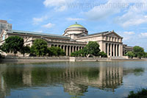
Rev HK-185, Aluminum, R-5
The Palace of Fine Arts
The Museum of Science and Industry
Obv HK-185b, Brass, R-5

Slide 13
Some Firsts at the 1893 World’s Columbian Exposition!
Aunt Jemima Pancake Mix (invented 1889, but trademarked in 1893)
Cracker Jack
Shredded Wheat
Juicy Fruit Chewing Gum
The Hamburger, making an appearance again at the Louisiana Purchase Exposition (St. Louis Worlds Fair) in 1904
USPS Commemorative Picture Postcards and Stamps

Slide 14
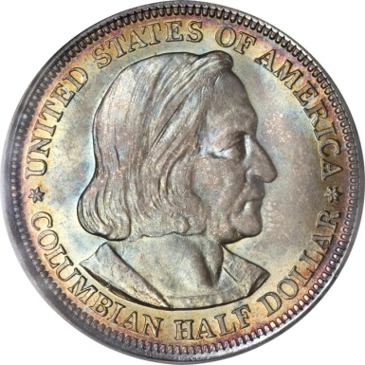
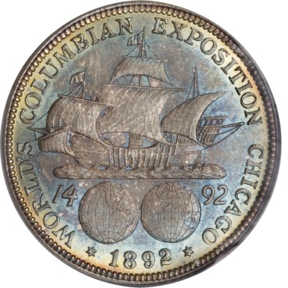
1892 & 1893 World’s Columbian Exposition
Obv: Columbus/Rev: Santa Maria; Columbus’s Flag Ship
Net Distribution:
1892: 950,000
1893: 1,550,000
Designers: Charles E. Barber (Obv), George T. Morgan (Rev)
The First U.S. Commemorative Coin!
The first U.S. coin to depict a real person and the first U.S. coin to depict a foreigner!
The U.S. Mint had an exhibit at the Exhibition which included on display an 1804 silver dollar. There was also a coin press
on location that was stamping out medals!
Many of the half dollars went unsold and were released into circulation
A recession was going on in the early 1890’s and it was fortunate that they sold as many coins as they did

Slide 15
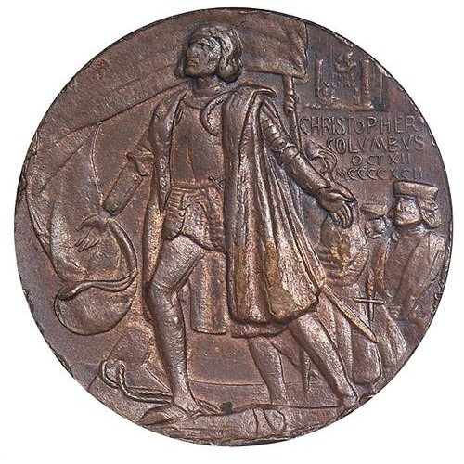
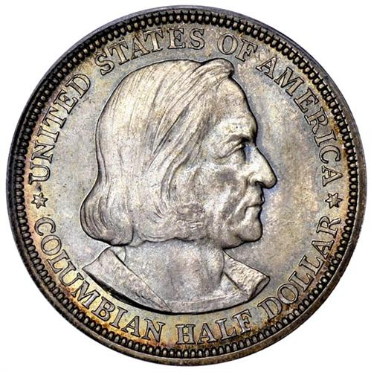
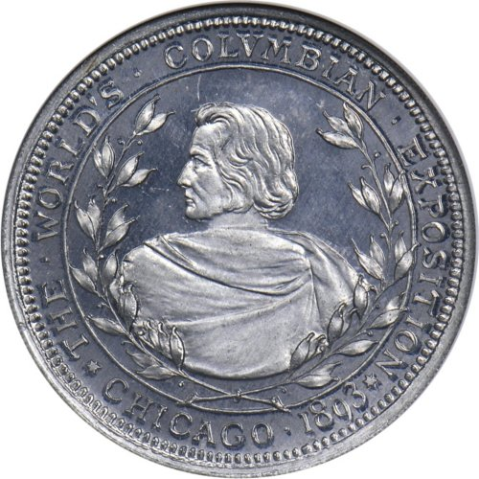
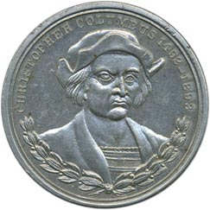
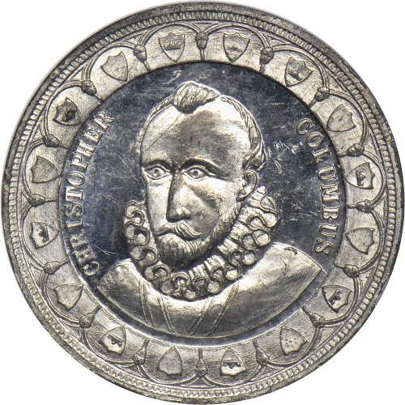
1892 Medal by Enrique Lppez-Lorensis
(Adapted From a 1512 Image By An Anonymous Artist
-From Taxay)
Commemorative Half Dollar
MS-65
HK-223, Obv, MS-63
HK-183, Obv, MS-62
Photo: R. Zenon Lada
HK-236a, Obv
230a, Obv, MS-62 PL

Slide 16
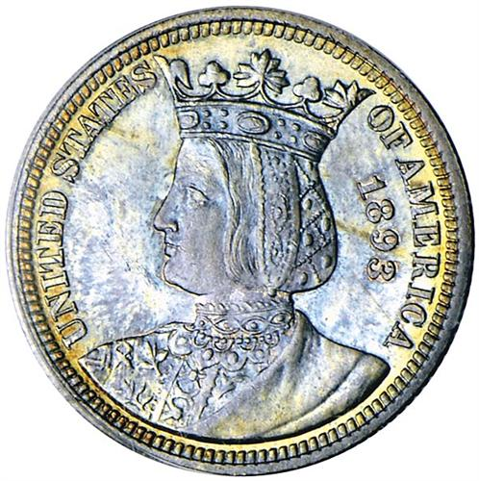
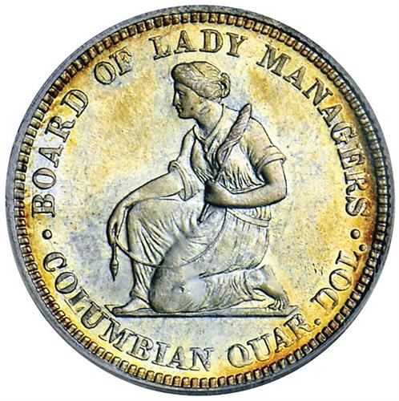
1893 Isabella Quarter (World’s Columbian Exhibition)
Obv: Queen Isabella/Rev: Kneeling Woman
Net Distribution: 24,214
Designer: Charles E. Barber
The only commemorative quarter dollar ever minted!
The Board of Lady managers was formed at the insistence of Susan B. Anthony so that women would be represented at
the Exhibition
The Isabella quarter is the first U.S. coin to depict foreign royalty with the obverse depicting the bust of Queen Isabella
who helped fund Columbus’s voyage
As with the Columbian half dollar, the Isabella quarter also sold for $1. People thought it was bad enough paying $1
for a coin with a 50 cent denomination, but to pay $1 for a quarter was even worse. The quarter did not sell
well. There was little publicity for the coin (unlike the half dollar) and a recession was going on at the time
These coins were handled with better care than the Columbian half dollars and thus typically have fewer marks

Slide 17
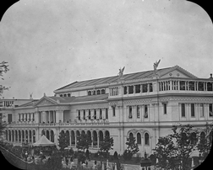
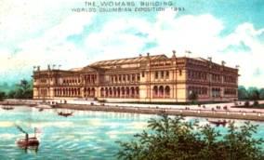
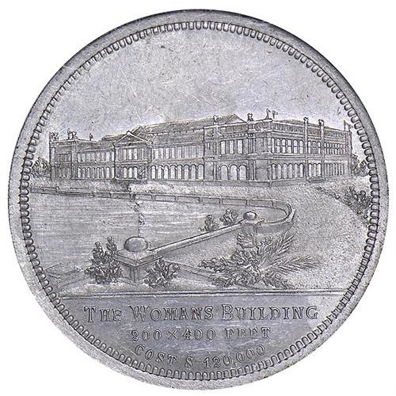
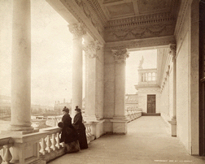
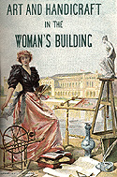
Courtesy University of Chicago
Postcard of the “Woman’s Building”
at the 1893 Columbian Exposition
Rev HK-199 MS-62 Aluminum, R-5
Courtesy University of Chicago

Slide 18
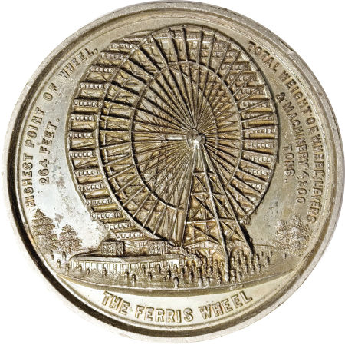
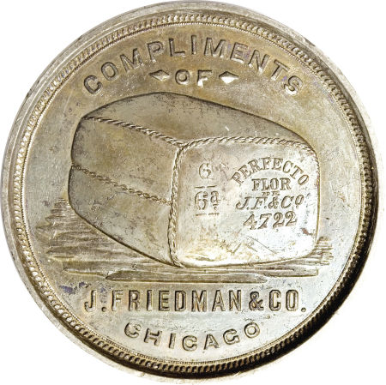
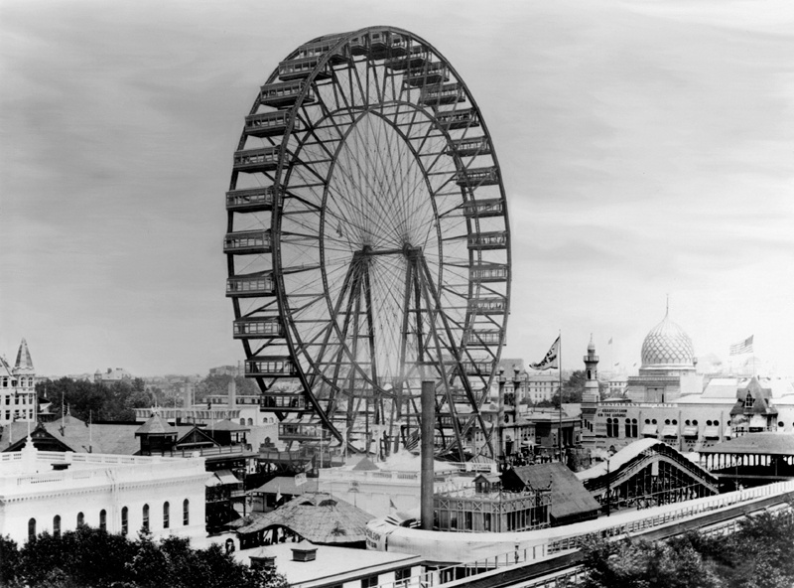
The first Ferris Wheel appeared at the Columbian Exposition, 1893!
Each gondola would carry 40 people
and it cost 50 cents to ride
HK-170 Aluminum, R-4 MS-61

Slide 19
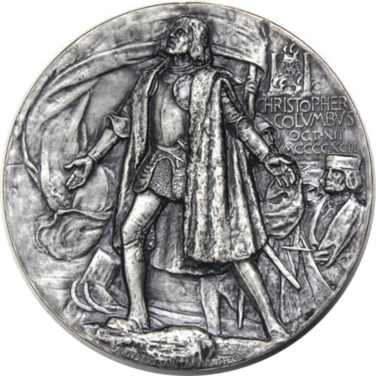
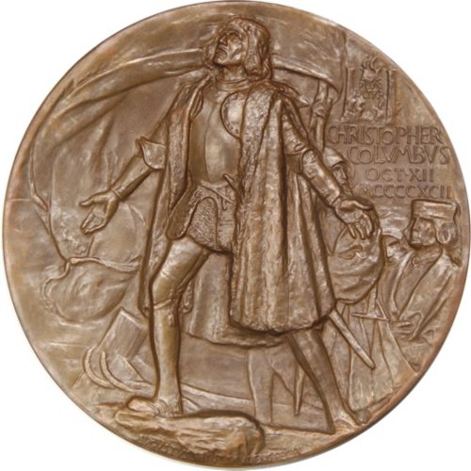
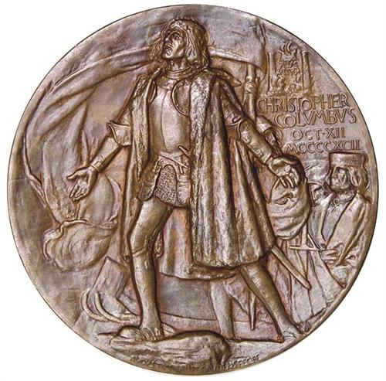
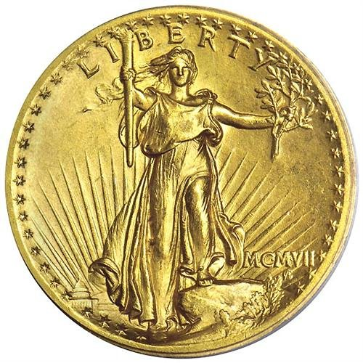
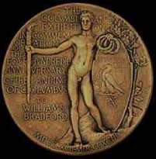
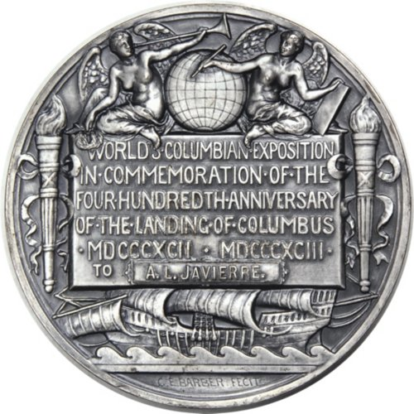
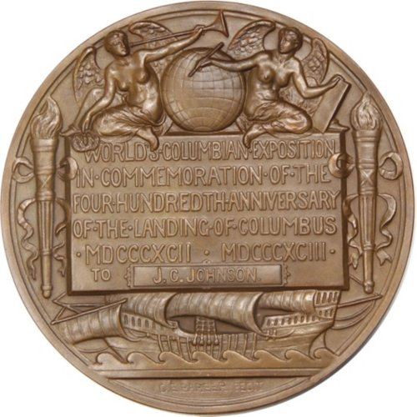
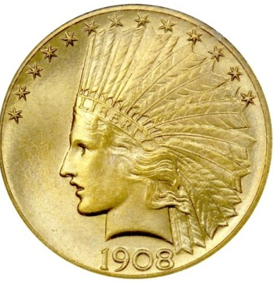
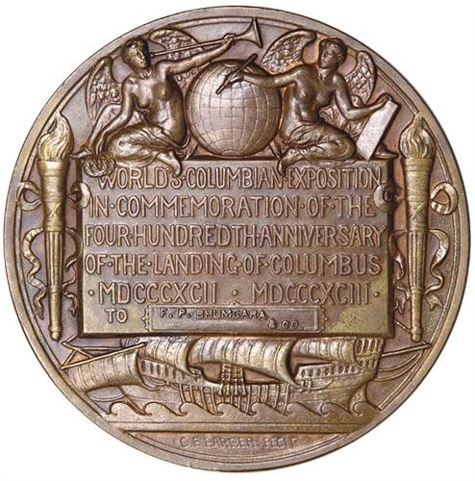
38mm, Obv., HR-223, Copper, R-5
Official Awards Medal for World’s Columbian Exposition
Silver, 76.5mm Obv: Augustus St. Gaudens/Rev: Charles E. Barber
1907 $20 MS-63
Official Awards Medal for World’s Columbian Exposition
Bronze, 76.6mm Obv: Augustus St. Gaudens/Rev: Charles E. Barber
1908 $10 MS-66
Rejected Original Reverse Design
By St. Gaudens

Slide 20
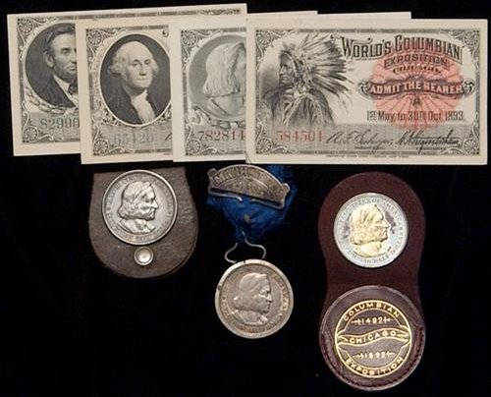

Slide 21
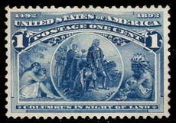
1892 Columbus Commemorative Stamp Issues
Only 27,350 made!

Slide 22
1904 Louisiana Purchase Exposition
St. Louis, Missouri
Commemorated the 100th Anniversary of the Louisiana Purchase
St. Louis Was the Territorial Capital in 1804
Exposition Held on 1270 Acres
Originally Planned to Open in 1903 but Delayed Until 1904
All States and Territories and “Dozens” of Countries Were Represented
Featured Exhibits Included Cars and Wire Less Communications
(a Car Had Traveled To The Exposition From New York!)
Two Commemorative Coin Varieties Were Issued and Approximately
20 Dollar Sized Medals
Approximately 20,000,000 Attended

Slide 23
1903 Louisiana Purchase Exposition Gold Dollar
Obv #1: Thomas Jefferson, Obv #2 William McKinley
Rev: Dates, Denomination, Olive branch
Net Distribution: 17,500 (of each variety)
Designer: Charles E. Barber
Thomas Jefferson is on the obverse of one coin because he was president at the time of the Louisiana Purchase. Barber copied the
Jefferson portrait from Jefferson’s image on the 1801 Indian Peace Medal (designed by John Reich)
William McKinley is on the obverse of the other coin because he was the president who signed the bill authorizing the government to
provide $5,000,000 to support the Exposition. Also, his assassination in 1901 was still on the minds of the American people.
The coins were offered for $3.00 each – a very high price for the time. Sales were slow and 205,000 were returned to the mint with
no accounting of which coins were Jefferson or which were McKinley coins so the net distribution numbers are estimates
though it is known that a total of both types distributed was 35,000.

Slide 24
HK-299, Silver, R-4
HK-299, Silver,
No “Star” Variety
HK-300, Gold Plated Bronze, R-3
HK-310, Brass, R-5
“Good Luck Dollar”

Slide 25
1904 Louisiana Purchase Exposition
Government Building
HK-316 (Rev) R-5, Aluminum
Photo by Jonathan Breecher

Slide 26
The “Electricity Building” at the Louisiana Purchase Exposition in St. Louis
HK-322c, R-5, Aluminum
Electricity Building
Photo by Jonathan Breecher

Slide 27
The Art Palace at the Louisiana Purchase Exposition
HK-321, Aluminum, R-5
(Art Palace Below)
The Saint Louis Art Museum

Slide 28
57.2 mm, 5.1157 Troy Ounces Gold Medal
“Gold “ Medal (Bronze!)
All Designed by Adolf Alexander Weinman!
“Silver” Medal (Bronze!)

Slide 31
1905 Lewis and Clark Centennial Exposition
Portland, Oregon
Commemorated the 100th Anniversary Of Meriwether Lewis and William Clark’s
Expedition (1804-1806) into the Lands of the Louisiana Purchase
(“Corps of Discovery”)
Site was on 200 Acres Near Portland
Exhibit Emphasis Was Placed Upon
Fisheries, Forestry and Mining
Official Medals Were Minted on Site
Attendance Was Approximately 2,500,000
Two (One Type) Gold Commemorative Coins Were Issued
Hibler and Kappen Lists Four Types of So-Called Dollars
(Struck of Various Metals and Plating)

Slide 32
1904, 1905 Lewis and Clark Exposition Gold Dollar
Obv: Captain Meriwether Lewis
Rev: William Clark
Net Distribution: 1904: 10,025, 1905: 10,041
Designer: Charles E. Barber
The coins sold for $2.00 but after getting ripped off by paying $3.00 a coin for the 1903 Louisiana Purchase gold
dollars (which subsequently could be bought for $2.00), there weren’t many takers for the Lewis and Clark
gold dollars
Most coins show wear and nice mint state examples are not easy to find – much rarer than the Louisiana Purchase
gold dollars. Even low grade coins are not very common. Apparently most coins were sold to the general
public and not to collectors or dealers
In 1901 the $10 “Bison” note was issued in part to help generate interest in the Louisiana Purchase Exposition and
the Lewis and Clark Exposition

Slide 33
Exterior of the Forestry Building (moved then burned down in 1964)
Guild Lake
Interior of the Forestry Building

Slide 34
The Official Lewis and Clark Centennial Exposition Medal
1905 HK-325, Silver, MS-63, R-5
1905 HK-332, Bronze, R-6, Reeded Edge
U.S. Government Bldg on reverse
HK-333b “No Date”, Antiqued Silver,
R-6, Plain Edge

Slide 35
Awards Medal
63mm, Gilt Bronze
“Un-Awarded”
“Awarded”

Slide 36
“1/4” Gold
10mm
“1/2” Gold

Slide 37
1901-1925 (MS-63)

Slide 38
Fairmont Hotel, built in 1905 for the Lewis and Clark Exposition…and still standing!

Slide 39
Panama-Pacific International Exposition
1915
San Francisco, California
Celebrated the 1914 Opening of the Panama Canal
Also Celebrated the 400th Anniversary of the Discovery of the Pacific Ocean
And the Rebuilding of San Francisco Following the 1906 Earthquake
Built on a 635 Acre Area
44 States and Territories Participated and
42 Foreign Countries Were Represented
The U.S. Mint Was Again Present and Struck the Official Medals Onsite
Five Commemorative Coins Were Minted in San Francisco For This Event
Hibler and Kappen Lists 27 Types of So-Called Dollars
Other Medals and Tokens Were Also Struck
Over 18,000,000 Attended

Slide 40
Panama-Pacific Exposition
The Palace of Fine Arts Building – and still Standing!

Slide 41
1915-S Panama-Pacific International Exhibition
Obv: Columbia (Liberty)/Cherub
Rev: Eagle on a Shield
Net Distribution: 27,134
Designers: Charles E. Barber (Obv)
George T. Morgan (Rev)
The 1st commemorative coin to be minted at a branch mint (San Francisco) and the first commemorative
coin to depict “Liberty” (Columbia)
The Panama-Pacific half dollar was part of a five coin set issued for the Exhibition which were all minted
in San Francisco: $1 gold piece, $2 ½ gold piece, $50 gold piece (two varieties).

Slide 42
1915-S Panama-Pacific Exhibition Gold Dollar
Obv: Worker
Rev: Denomination and Dolphins
Net Distribution: 15,000
Designer: Charles Keck
The obverse design drew some derision with some saying that the worker looked like a baseball player but many
liked the idea of a laborer being the central motif
The reverse with the two dolphins symbolizes the joining of the two oceans (via the Panama Canal)
Most coins today are found in mint state indicating that collectors purchased most of the coins

Slide 43
1915-S Panama-Pacific $2 ½ Gold Piece
Obv: Liberty astride a “Hippocampus”
Rev: Eagle
Net Distribution” 6,749
Designer: Obv: Charles E. Barber
Rev: George T. Morgan
One of only two $2 ½ dollar gold commemorative coins minted (the 1926 Sesquicentennial was the other!)
The reverse by George T. Morgan is of an eagle upon a pedestal that was copied from an 1877 pattern dollar and
half dollar with the “defiant eagle reverse” (J-1608 & J-1512)
These coins are scarce especially in higher mint state (MS-63 to MS-65). Many were spent and are found in worn
condition.

Slide 44
Morgan’s “Defiant Eagle”: If it ain’t broke, don’t fix it!
1877 (J-1513)
Copper Half Dollar
Proof 69 Brown
1877 (J-1512)
Silver Half Dollar
Proof 62
Reverse
1915-S Pan-Pac
$2 ½
MS-66
1879 (J-1608)
Silver “School Girl” Dollar
Proof 63
1879 (J-1609)
Copper “School Girl” Dollar
Proof 66 RB

Slide 45
1915-S Panama-Pacific $50 Gold Piece
Two Varieties: Round & Octagonal
Obv: Minerva, Goddess of Wisdom
Rev: Owl
Net Distribution: Round - 483, Octagonal - 645
Designer: Robert I. Aitken
These Octagonal Commemoratives are the only non-round commemorative coins stuck
The obverse depicts Minerva, the Greek mythological goddess of wisdom (the helmet is pushed back indicating
peaceful intentions)
The reverse with an owl also depicts wisdom and the owl was sacred to Minerva
The dates are in Roman numerals and placed upon a shield.
Many of these coins are found in MS-63 and MS-64 (collectors bought and preserved them!)
As Breene and Swiatek mention in their jointly authored commemorative book: “these have long been considered
the caviar and truffles of the United States commemorative issues, especially in original cased sets”

Slide 46
1851 Augustus Humbert $50 U.S. Assay Office Lettered Edge MS-61
MS-66
1852 Augustus Humbert $50 U.S. Assay Office Lettered Edge AU-55

Slide 49
Panama-Pacific Exposition
Exposition Medals
Designed
By
Robert I. Aitken
(also designed the $50 Pan-Pac Commemorative gold piece,
The Missouri Commemorative Half & the California-Pacific
Exposition (San Diego) Commemorative Half
Gold
Plated (Gilt)
HK-401
All Struck at the
U.S. Mint Exhibit
at the Exhibition
Silver
HK-399
Bronze
HK-400

Slide 50
Panama-Pacific Exposition Official Award Medal (70.5mm)
Designed By
John Flannigan (who designed the Washington Quarter)

Slide 51
Postage From 1915: Balboa, Panama Canal, Golden Gate, San Francisco Bay

Slide 52
State Fund “Dollars”
Florida
HK-404a, R-5
Maryland
HK-407, R-5
Montana
HK-409, R-4

Slide 53
“Countries”
Sweden
50.7mm
France
51.2mm

Slide 54
HK-1030, 19mm
Gold Dollar
Gold Dollar
Made For Exhibition
“Grizzley Bear” Lucky Penny 51mm, Bronze

Slide 55
Admission Badges

Slide 56
Panama-Pacific Exposition
World’s Columbian Exposition
Louisiana Purchase Exposition
Lewis and Clark Centennial Exposition

